Slide 1
Locally Testable Codes and Locally Correctable Codes approaching the Gilbert-Varshamov bound
Shubhangi Saraf
Rutgers
Joint work with
Sivakanth Gopi, Swastik Kopparty, Rafael Oliveira, Noga Ron-Zewi

Slide 2
This talk
Error-correcting codes with:
  low redundancy
  robust to large fraction of errors
  sublinear time error-detection and error-correction algorithms

Slide 3

Error-correcting codes
C $⊆$ ${\left\{0,1\right\}}^{n}$ (with Hamming metric)
Rate R:
  |C| = $2^{Rn}$
Distance $δ$:
  $Δ\left(x,y\right)≥δn$
  for distinct $x,y∈$ C
  Implies $δ/2$-fraction errors can be corrected
{0,1}^{n}
r
c
Codewords

Slide 4
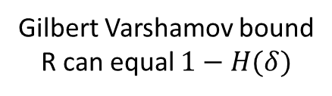


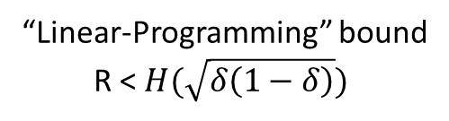
Error-correcting codes
1
C $⊆$ ${\left\{0,1\right\}}^{n}$ (with Hamming metric)
Rate R:
  |C| = $2^{Rn}$
Distance $δ$:
  $Δ\left(x,y\right)≥δn$
  for distinct $x,y∈$ C
  Implies $δ/2$-fraction errors can be corrected
Rate vs. Distance?
  OPEN
R
“Linear-Programming” bound
R < $H(\sqrt{δ\left(1−δ\right)})$
0
$$δ$$
Gilbert Varshamov bound
R can equal $1−H(δ)$
1/2

Slide 5
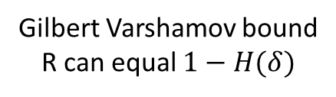
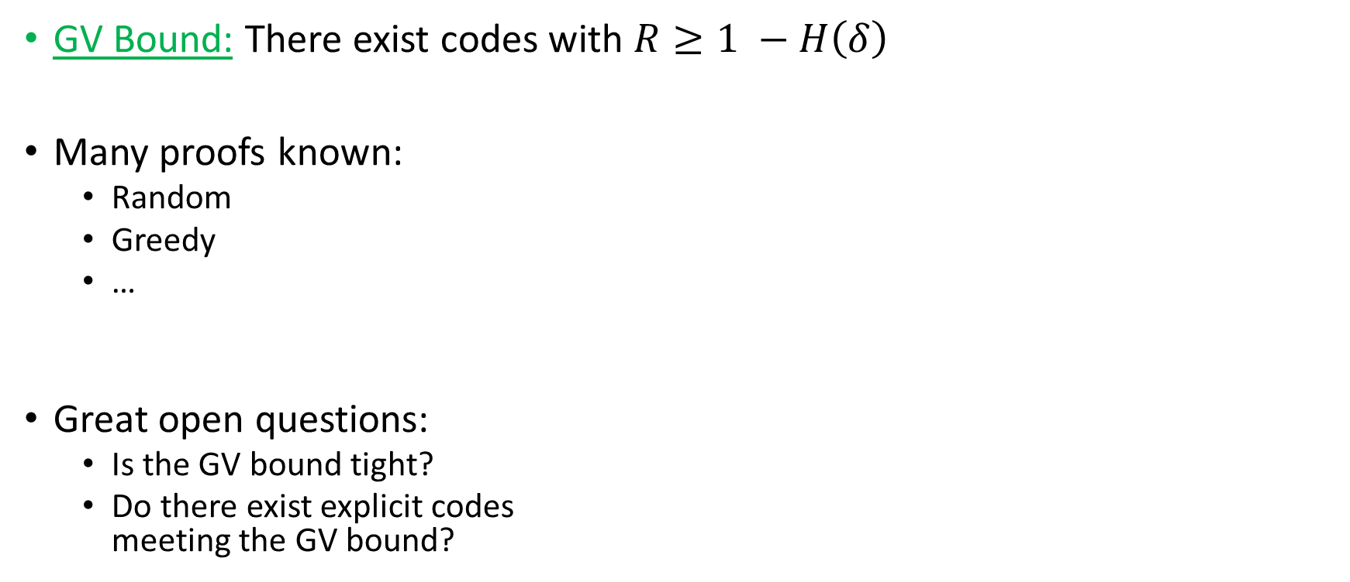


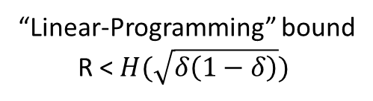
Gilbert Varshamov bound
GV Bound: There exist codes with $R≥1 −H\left(δ\right)$
Many proofs known:
  Random
  Greedy
  …
Great open questions:
  Is the GV bound tight?
  Do there exist explicit codes
  meeting the GV bound?
1
Over large alphabets
R = 1 - $δ$ is the optimal tradeoff
(a.k.a. SINGLETON BOUND)
Achieved explicitly
R
“Linear-Programming” bound
R < $H(\sqrt{δ\left(1−δ\right)})$
0
$$δ$$
Gilbert Varshamov bound
R can equal $1−H(δ)$
1/2

Slide 6
Goals of classical coding theory
Basic algorithmic tasks:
  Encoding
  Testing (error detection)
  Decoding (error correction)
Today we know codes with:
  good rate-distance tradeoff
  efficient encoding, testing, decoding
  Linear/near-linear time

Slide 7
Local Codes
Meanwhile, in early 90s complexity theory:
  answers to questions that had never been asked
Can we work with codes in sublinear time?
In particular, what can we do with sublinear # queries?

Slide 8

Local Testing, Decoding/Correcting
Local Testing:
  Given $r∈{\{0,1\}}^{n}$
    distinguish between $r∈C$ and $Δ\left(r,C\right)>εn$
Local Correcting:
  Given $r∈{\{0,1\}}^{n} and j∈\left[n\right]$
    if $∃ c∈C$ such that $Δ\left(r,c\right)<εn,$
    find $c_{j}$
Goal: use few queries to r
Always assume $ε=Ω\left(1\right)$

Slide 9


Locally Testable Code
Given: $r∈Σ^{n}$
Is $r$in $C$?
Accept
Local Tester
Reject

Slide 10

Locally Correctable Codes
Given: $r∈Σ^{n}$ such that $Δ\left(r,C\right)<εn$
Given: $i∈[n]$
Local Corrector
i
c_{i}

Slide 11

A nice local code
Reed-Muller codes (multivariate polynomial evaluation codes)
  constant rate, constant distance
  O($n^{ε}$) query locally testable
  O($n^{ε}$) query locally decodable
Large finite field F_{q} of size q
Interpret original data as a polynomial P(X,Y)
  degree(P) = d = 0.1 q
Encoding:
  Evaluate P at each point of F_{q}²
Rate = $Ω(1)$
Distance = 0.9
  Two low degree polynomials cannot
  agree on many points of F_{q}²
F_{q}²

Slide 12
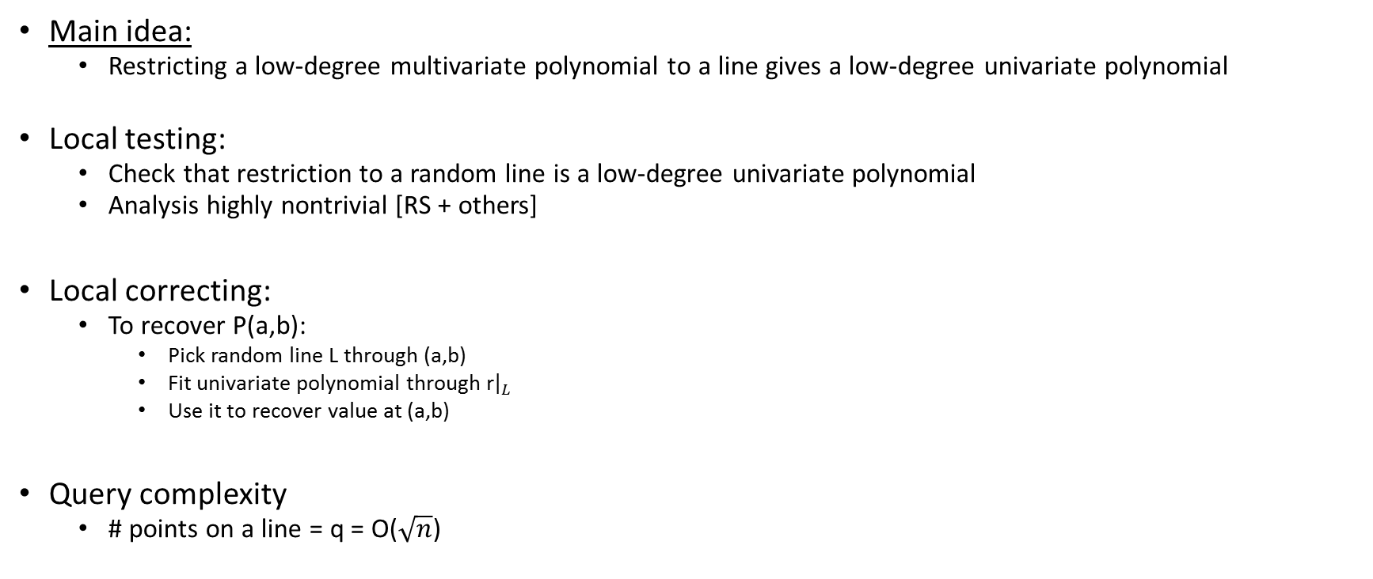
Local testing/correcting RM codes
Main idea:
  Restricting a low-degree multivariate polynomial to a line gives a low-degree univariate polynomial
Local testing:
  Check that restriction to a random line is a low-degree univariate polynomial
  Analysis highly nontrivial [RS + others]
Local correcting:
  To recover P(a,b):
    Pick random line L through (a,b)
    Fit univariate polynomial through r${\left.​\right|}_{L}$
    Use it to recover value at (a,b)
Query complexity
  # points on a line = q = O($\sqrt{n}$)
(a,b)
L
F_{q}²

Slide 13
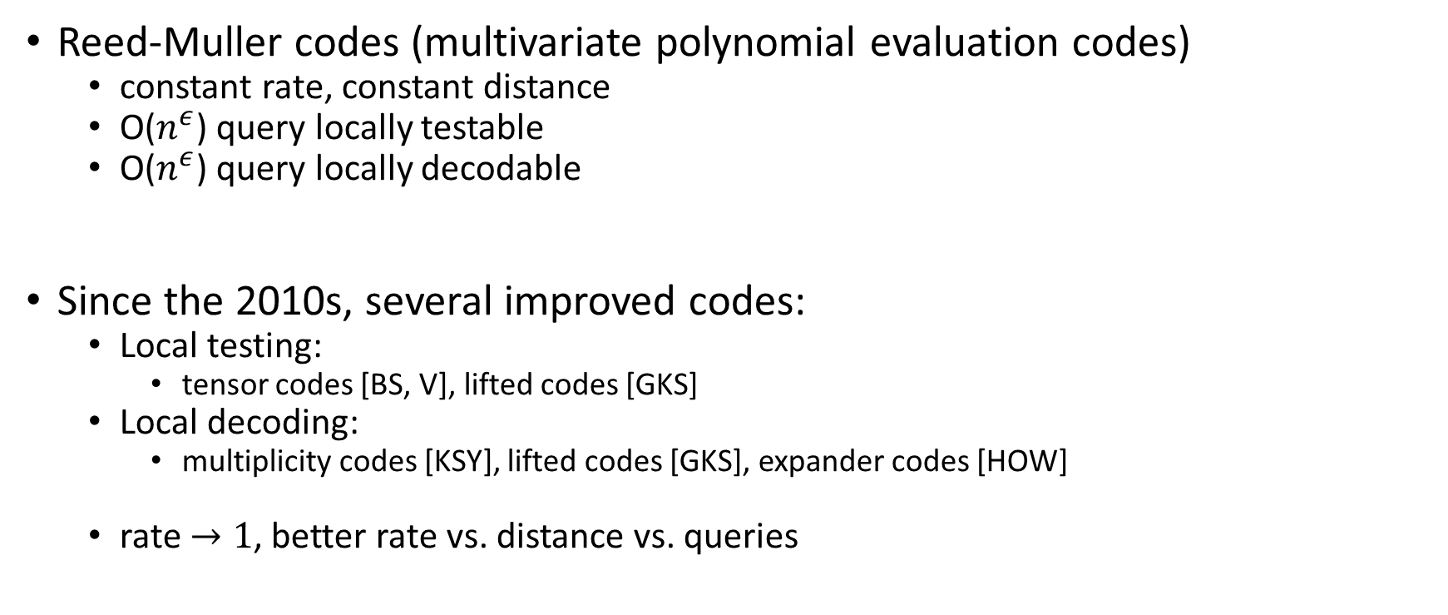
Local codes of constant rate
Reed-Muller codes (multivariate polynomial evaluation codes)
  constant rate, constant distance
  O($n^{ε}$) query locally testable
  O($n^{ε}$) query locally decodable
Since the 2010s, several improved codes:
  Local testing:
    tensor codes [BS, V], lifted codes [GKS]
  Local decoding:
    multiplicity codes [KSY], lifted codes [GKS], expander codes [HOW]
  rate $→1$, better rate vs. distance vs. queries

Slide 14
Plan of talk
Survey of some of the recent results on LTCs, LDCs, LCCs
This work:
  Codes over the {0,1} alphabet.
  What is the best possible rate/distance tradeoff achievable for LTCs/LCCs?
  New result: LTCs and LCCs approaching* Gilbert-Varshamov bound

Slide 15
Constant query setting
LCCs, LDCs, LTCs extensively studied in constant query setting
Many deep and amazing results
  Both upper and lower bounds
Many basic open problems unanswered

Slide 16

What we know about constant rate LCCs
[Katz-Trevisan]:
  Constant rate $⇒$ must have query complexity $Ω(\log{n})$
RM codes achieve:
  For all R < 1/$exp⁡(\frac{1}{β})$
  Query complexity = $O(n^{β} )$
Recent progress beyond Reed-Muller codes:
  For all R < 1
  For all $β>0$
  Query complexity = $O(n^{β})$
  Three familes of codes achieving this!
    Multiplicity codes [Kopparty-S-Yekhanin]
    Lifted Reed-Solomon codes [Guo-Kopparty-Sudan]
    Expander codes [Hemenway-Ostrovsky-Wootters]

Slide 17

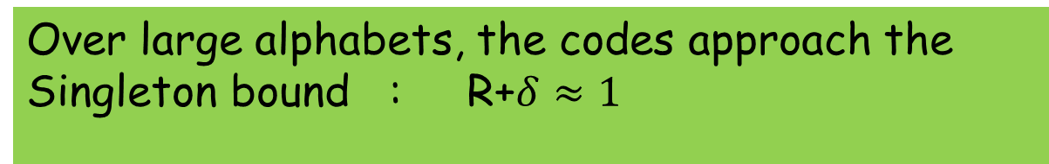
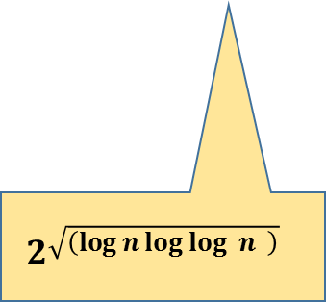
More recently:
[Kopparty-Meir-RonZewi-S `16]: There exists a family of codes of rate $1−ε$ that is locally decodable and locally correctable with $n^{o\left(1\right)}$ queries from a constant fraction of errors.
$$2^{\sqrt{\left(\log{n\log{\log{ }n }}\right)} }$$
    Over large alphabets, the codes approach the Singleton bound : R+$δ≈1$

Slide 18
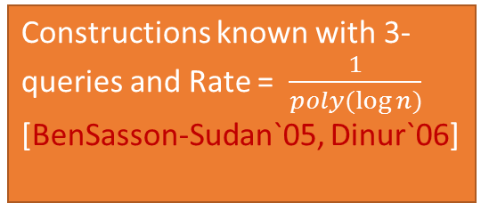

What we know about constant rate LTCs
Constructions known with 3-queries and Rate = $\frac{1}{poly(\log{n)}}$ [BenSasson-Sudan`05, Dinur`06]
As far as we know,
  there could be 3-query LTCs of constant rate
RM codes achieve:
  For all R < 1/$exp⁡(\frac{1}{β})$
  Query complexity = $O(n^{β} )$
Recent progress beyond Reed-Muller codes:
  For all R < 1
  For all $β>0$
  Query complexity = $O(n^{β})$
  Two familes of codes achieving this!
    Tensor codes [BenSasson-Sudan], [Viderman]
    Lifted Reed-Solomon codes [Guo-Kopparty-Sudan]

Slide 19

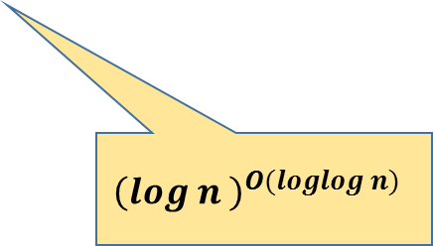
More recently:
[Kopparty-Meir-RonZewi-S `16]: There exists a family of codes of rate $1−ε$ that are locally testable with $n^{o\left(1\right)}$ query complexity.
$${\left(log n \right)}^{O(loglog n)}$$
    Over large alphabets, the codes approach the Singleton bound : R+$δ≈1$

Slide 20

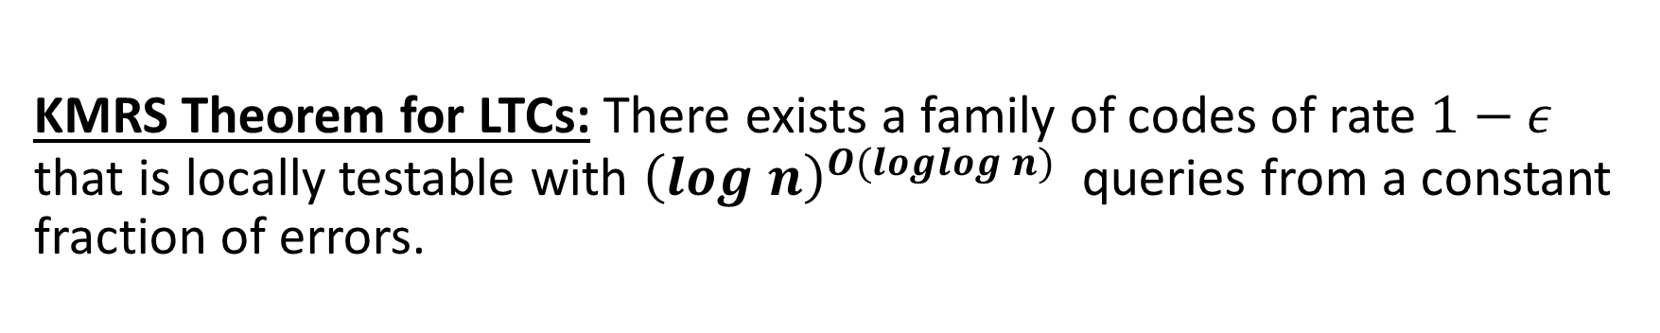
KMRS Theorem for LCCs: There exists a family of codes of rate $1−ε$ that is locally decodable and locally correctable with $2^{\sqrt{\left(\log{n\log{\log{ }n }}\right)} }$ queries from a constant fraction of errors
KMRS Theorem for LTCs: There exists a family of codes of rate $1−ε$ that is locally testable with ${\left(log n\right)}^{O(loglog n)}$ queries from a constant fraction of errors.
    Over large alphabets, the codes approach the Singleton bound : R+$δ≈1$

Slide 21
Proof of KMRS result: 2 components
Component 1: High rate codes with sub-polynomial query complexity but only tolerating a tiny sub-constant fraction of errors
Component 2: “Distance Amplification”
  Takes code as above and transforms it to a code that can tolerate many more errors

Slide 22
Component 1 (for LCCs)
High rate codes with sub-polynomial query complexity but only tolerating a tiny sub-constant fraction of errors
Can be achieved by Multiplicity Codes!
(In a regime of parameters not studied before)

Slide 23
Multiplicity codes
Generalizing Reed-Muller codes
  Instead of taking values of polynomials,
  evaluate polynomials along with partial derivatives
Apparently reduces the rate:
  since each polynomial is encoded into a longer string
But the distance improves:
  and we can now take much higher degree polynomials
Overall tradeoff for Rate v Distance is better
  Allows rates -> 1
Allows for local decoding
  by restricting to multiple generic lines through a point.

Slide 24
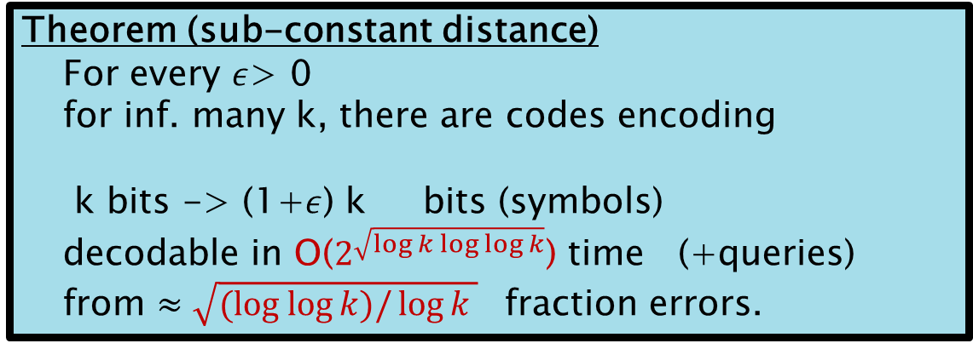

Multiplicity Codes
[Kopparty-S-Yekhanin`11]
Theorem (original)
  For every $ε$> 0,
  for inf. many k, there are codes encoding
  k bits -> (1+$ε$) k bits (symbols)
    decodable in O($k^{ε}$) time (+queries)
    from $δ\left(ε\right)$> 0 fraction errors.
Theorem (sub-constant distance)
  For every $ε$> 0
  for inf. many k, there are codes encoding
  k bits -> (1+$ε$) k bits (symbols)
    decodable in O($2^{\sqrt{\log{k\log{\log{k}}}}}$) time (+queries)
    from $≈\sqrt{(log log{k)/\log{k} }}$ fraction errors.

Slide 25
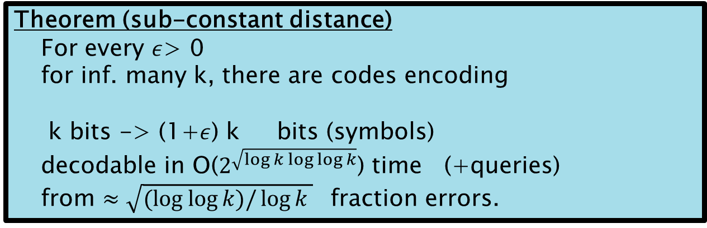
Component 2
Distance amplification
  Similar technique used by [Alon-Edmonds-Luby’96] and then by others [GI’05, GR’08]
Theorem (sub-constant distance)
  For every $ε$> 0
  for inf. many k, there are codes encoding
  k bits -> (1+$ε$) k bits (symbols)
    decodable in O($2^{\sqrt{\log{k\log{\log{k}}}}}$) time (+queries)
    from $≈\sqrt{(log log{k)/\log{k} }}$ fraction errors.

Slide 26

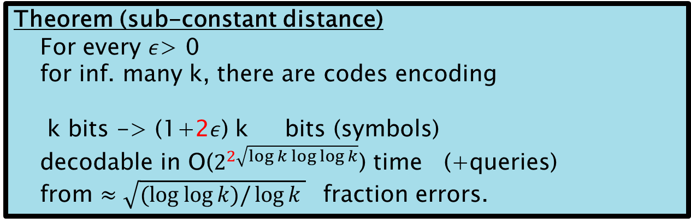

Component 2
Distance amplification
  Similar technique used by [Alon-Edmonds-Luby’96] and then by others [GI’05, GR’08]
Theorem (sub-constant distance)
  For every $ε$> 0
  for inf. many k, there are codes encoding
  k bits -> (1+2$ε$) k bits (symbols)
    decodable in O($2^{2\sqrt{\log{k\log{\log{k}}}}}$) time (+queries)
    from $≈\sqrt{(log log{k)/\log{k} }}$ fraction errors.
$$Ω(1)$$
With $R +δ = 1−ε$

Slide 27













$$a_{1} a_{2} a_{3}$$
$$a_{1}$$
$$a_{2}$$
Each block is symbol in final alphabet
$$b_{1} b_{2} b_{3}$$
$$b_{1}$$
Reed Solomon encoding
$$b_{2}$$
$$a_{3}$$
$$b_{3}$$
Good expander
Multiplicity codeword
$$a_{3} b_{2} f_{1}$$
$$f_{1}$$
$$f_{2}$$
$$f_{1} f_{2} f_{3}$$
$$f_{3}$$

Slide 28
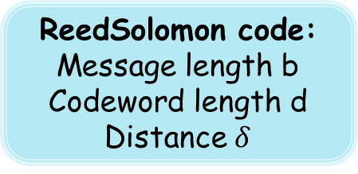
$$a_{1} a_{2} a_{3}$$
$$a_{1}$$
$$a_{2}$$
Each block is symbol in final alphabet
$$b_{1} b_{2} b_{3}$$
$$b_{1}$$
Reed Solomon encoding
$$b_{2}$$
$$a_{3}$$
ReedSolomon code:
Message length b
Codeword length d
Distance $δ$
$$b_{3}$$
Good expander
Multiplicity codeword
$$a_{3} b_{2} f_{1}$$
$$f_{1}$$
$$f_{2}$$
$$f_{1} f_{2} f_{3}$$
$$f_{3}$$

Slide 29
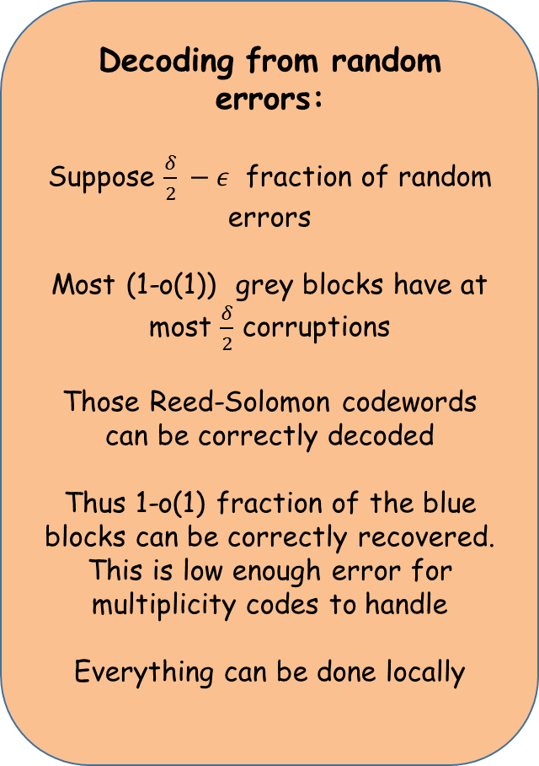
$$a_{1} a_{2} a_{3}$$
Decoding from random errors:
Suppose $\frac{δ}{2} −ε$ fraction of random errors
Most (1-o(1)) grey blocks have at most $\frac{δ}{2}$ corruptions
Those Reed-Solomon codewords can be correctly decoded
Thus 1-o(1) fraction of the blue blocks can be correctly recovered. This is low enough error for multiplicity codes to handle
Everything can be done locally
$$b_{1} b_{2} b_{3}$$
Reed Solomon encoding
ReedSolomon code:
Message length b
Codeword length d
Distance $δ$
Multiplicity codeword
$$f_{1} f_{2} f_{3}$$

Slide 30

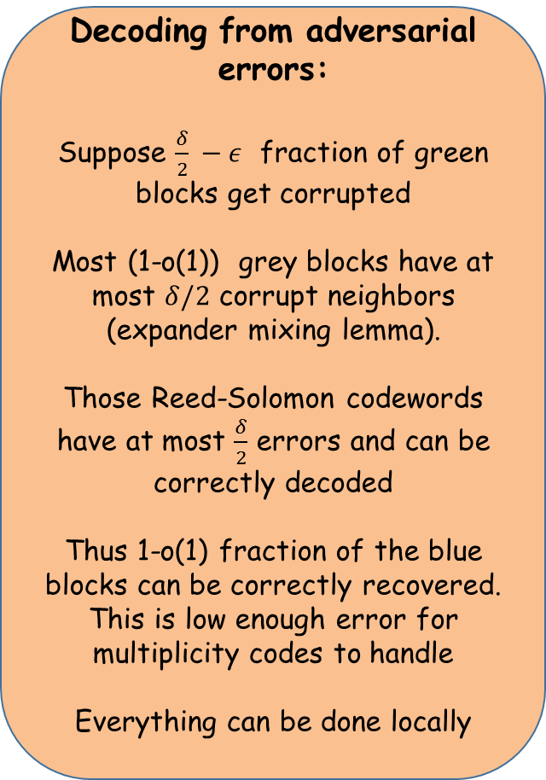
$$a_{1} a_{2} a_{3}$$
Decoding from adversarial errors:
Suppose $\frac{δ}{2} −ε$ fraction of green blocks get corrupted
Most (1-o(1)) grey blocks have at most $δ/2$ corrupt neighbors (expander mixing lemma).
Those Reed-Solomon codewords have at most $\frac{δ}{2}$ errors and can be correctly decoded
Thus 1-o(1) fraction of the blue blocks can be correctly recovered. This is low enough error for multiplicity codes to handle
Everything can be done locally
$$a_{1}$$
$$a_{2}$$
$$b_{1} b_{2} b_{3}$$
$$b_{1}$$
$$b_{2}$$
$$a_{3}$$
$$b_{3}$$
Expander + blocking makes the errors look pseudorandom
$$a_{3} b_{2} f_{1}$$
$$f_{1}$$
$$f_{2}$$
$$f_{1} f_{2} f_{3}$$
$$f_{3}$$

Slide 31
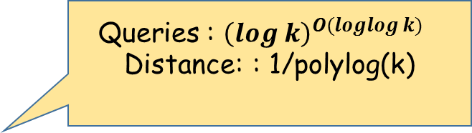
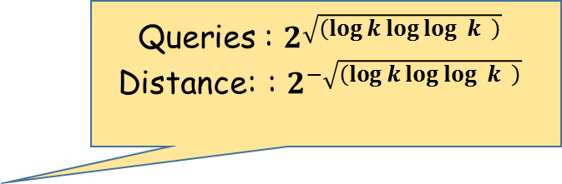
LTCs with subpolynomial query complexity
Very similar argument works for testability! Only component 1 changes
Component 1: High rate codes testable with sub-polynomial query complexity but with sub-constant distance
Can be achieved by tensor codes (in a regime of parameters not studied before)
[BenSasson-Sudan`06, Viderman`12]: Tensor codes are locally testable
Instantiate in regime of superconstant dimension
[KMRS `16]: Improved parameters – build codes by alternating tensoring and distance amplification
Queries : $2^{\sqrt{\left(\log{k\log{\log{ }k }}\right)} }$
Distance: : $2^{−\sqrt{\left(\log{k\log{\log{ }k }}\right)} }$
Queries : ${\left(log k\right)}^{O(loglog k)}$
Distance: : 1/polylog(k)

Slide 32
Plan of talk
Survey of some of the recent results on LTCs, LDCs, LCCs
This work:
  Codes over the {0,1} alphabet.
  What is the best possible rate/distance tradeoff achievable for LTCs/LCCs?
  New result: LTCs and LCCs approaching* Gilbert-Varshamov bound

Slide 33
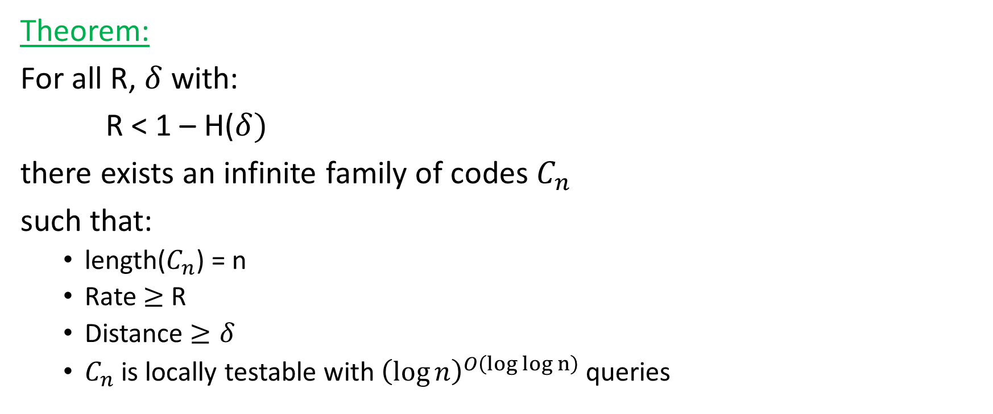
Main Result: LTCs
[Gopi-Kopparty-Oliveira-RonZewi-S `17]
Theorem:
For all R, $δ$ with:
R < 1 – H($δ)$
there exists an infinite family of codes $C_{n}$
such that:
  length($C_{n}$) = n
  Rate $≥$ R
  Distance $≥δ$
  $C_{n}$ is locally testable with ${\left(\log{n}\right)}^{O\left(log log n\right)}$ queries

Slide 34

Main Result: LCCs
[Gopi-Kopparty-Oliveira-RonZewi-S `17]
1
Theorem:
For all $δ$ with:
$δ∈\left(0.4999, 0.5\right)$
and all R with:
R < (0.99)$⋅$(1 – H($δ)$)
there exists an infinite family of codes $C_{n}$
such that:
  length($C_{n}$) = n
  Rate $≥$ R
  Distance $≥δ$
  $C_{n}$ is locally correctable from ($δ/2$–o(1))-fraction errors
  with $O\left(n^{0.1}\right)$ queries
R
“Linear-Programming” bound
0
$$δ$$
Gilbert Varshamov bound
1/2

Slide 35
Main Result: LCCs
1
Theorem:
For all $ε>0$, there exists $β_{0}$ s.t.
for all $δ$ with:
$δ∈\left(\frac{1}{2}−β_{0},\frac{1}{2}\right)$
and all R with:
R < $\left(1−ε\right)⋅$(1 – H($δ)$)
there exists an infinite family of codes $C_{n}$
such that:
  length($C_{n}$) = n
  Rate $≥$ R
  Distance $≥δ$
  $C_{n}$ is locally correctable from ($δ/2$–o(1))-fraction errors
  with $O\left(n^{ε}\right)$ queries
R
“Linear-Programming” bound
0
$$δ$$
Gilbert Varshamov bound
1/2

Slide 36
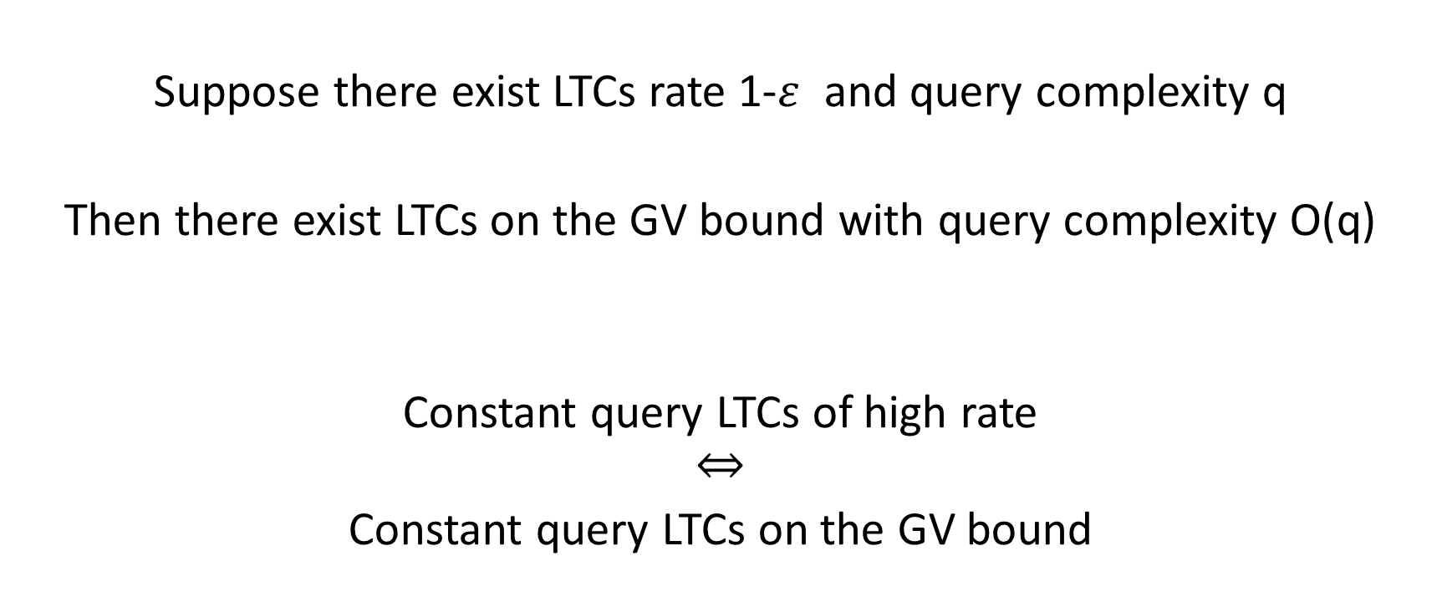
LTCs on the GV bound: a general reduction
Suppose there exist LTCs rate 1-$ε$ and query complexity q
Then there exist LTCs on the GV bound with query complexity O(q)
Constant query LTCs of high rate
$$⇔$$
Constant query LTCs on the GV bound

Slide 37
Plan
Thommesen’s theorem
  Randomly concatenated codes meet the GV bound
LTCs on the GV bound
Guruswami-Indyk-Sudan decoding strategy
  Unique-decoding Thommesen’s codes via list-decoding
LCCs on the GV bound

Slide 38
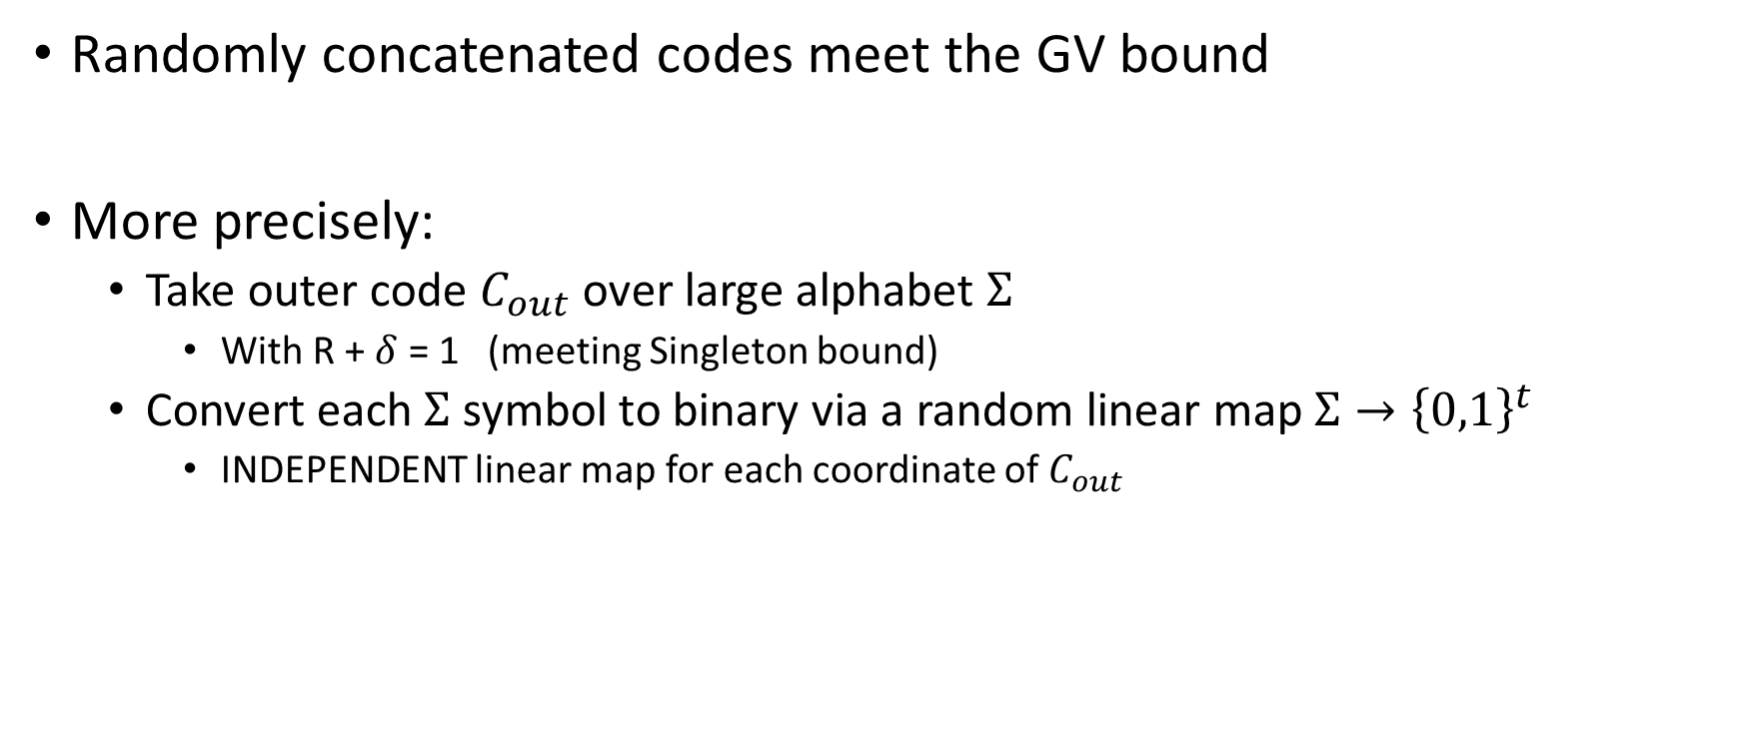
Thommesen’s theorem
Randomly concatenated codes meet the GV bound
More precisely:
  Take outer code $C_{out}$ over large alphabet $Σ$
    With R + $δ$ = 1 (meeting Singleton bound)
  Convert each $Σ$ symbol to binary via a random linear map $Σ→{\left\{0,1\right\}}^{t}$
    INDEPENDENT linear map for each coordinate of $C_{out}$
010…1
101…1

Slide 39
LTCs meeting the GV bound
Step 1:
  [KMRS] LTCs over large alphabets approaching the Singleton bound
Step 2:
  Concatenate with random linear codes in each position
Approaches the GV bound by Thommesen
Locally testability:
  Run the tester for large-alphabet code
  For each large-alphabet query, read the whole binary block
    If legal inner codeword, pass the symbol up to the tester
    Else reject

Slide 40
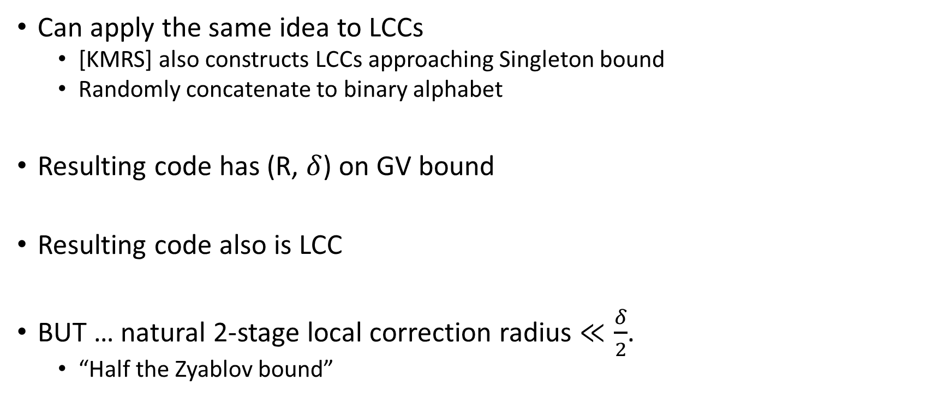
Same strategy for LCCs?
Can apply the same idea to LCCs
  [KMRS] also constructs LCCs approaching Singleton bound
  Randomly concatenate to binary alphabet
Resulting code has (R, $δ$) on GV bound
Resulting code also is LCC
BUT … natural 2-stage local correction radius $≪\frac{δ}{2}$.
  “Half the Zyablov bound”

Slide 41
Interlude: list-decoding
List-Decoding code C
  Given received word r
  Find LIST of all codewords c in C with $Δ\left(r, c\right)<ρ$
    Hopefully there are not too many
  Theorem (Johnson bound): If C has distance $\frac{1}{2}−β$, then list decoding from $ρ= \frac{1}{2}−\sqrt{β}$ fraction errors has small LIST size
For codes on GV bound, with $δ$ close to ½
  $\frac{δ}{2}≈\frac{1}{4}$
  Johnson radius $≈\frac{1}{2}$

Slide 42
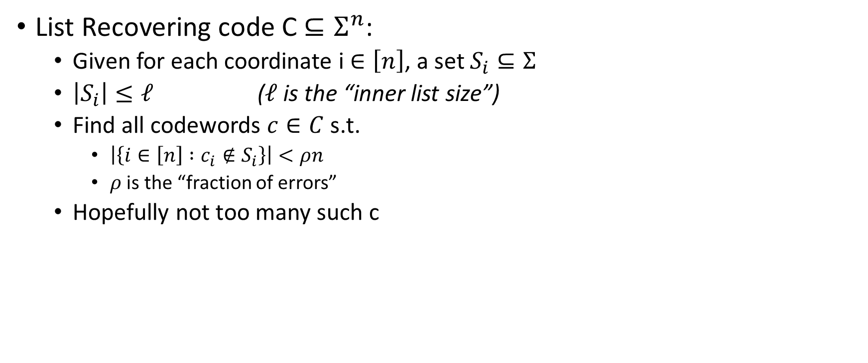
Interlude: list-recovering
List Recovering code C $⊆Σ^{n}$:
  Given for each coordinate i $∈\left[n\right]$, a set $S_{i}⊆Σ$
  $\left|S_{i}\right|≤ℓ$ ($ℓ$ is the “inner list size”)
  Find all codewords $c∈C$ s.t.
    $\left|\left\{i∈\left[n\right] :c_{i}∉S_{i}\right\}\right|<ρn$
    $ρ$ is the “fraction of errors”
  Hopefully not too many such c

Slide 43
Decoding of concatenated codes (nonlocal)
Decoding concatenated codes (non-locally):
  Given received word:
    Decode each inner codeword
    Pass decoded symbol up to the outer code
    Decode outer codeword
Guruswami-Indyk-Sudan:
  Can improve decoding radius using list-decoding
    List-decode each inner codeword from $\frac{1}{2}−η$ fraction errors
    Pass the list of decoded symbols up to the outer code
    List-recover outer codeword from 1 - $η$ fraction errors
  This can decode from $≈\frac{1}{2}$ fraction errors!
    Inner codes should have $δ≈\frac{1}{2}$
    Outer code should be $\left(ℓ, ρ\right)$-list-recoverable when
      $ℓ=$ big constant
      $ρ≈1$

Slide 44
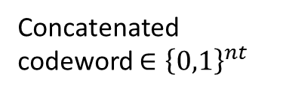



In pictures
Outer Codeword$∈Σ^{n}$
Concatenated codeword $∈{\left\{0,1\right\}}^{nt}$
010…1
101…1
010…1
101…1
Corrupted codeword $∈{\left\{0,1\right\}}^{nt}$
List decoding inner codes
List recovery of outer code
Candidate Codewords$∈Σ^{n}$

Slide 45
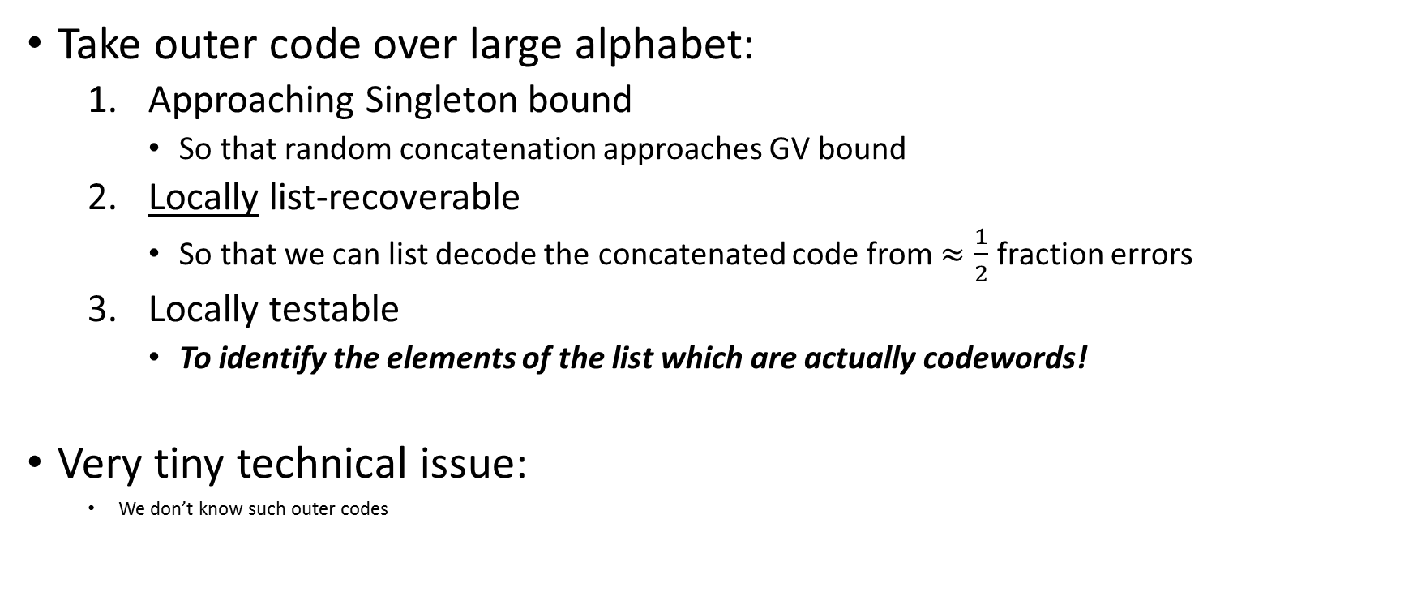
LCCs meeting the GV bound
Take outer code over large alphabet:
  Approaching Singleton bound
    So that random concatenation approaches GV bound
  Locally list-recoverable
    So that we can list decode the concatenated code from $≈\frac{1}{2}$ fraction errors
  Locally testable
    To identify the elements of the list which are actually codewords!
Very tiny technical issue:
  We don’t know such outer codes

Slide 46
LCCs meeting the GV bound
Take outer code over large alphabet:
  Approaching Singleton bound with “decent” rate-distance tradeoff
    So that random concatenation (1-$ε$) approaches GV bound
  Locally list-recoverable
    So that we can list decode the concatenated code from $≈\frac{1}{2}$ fraction errors
  Locally testable
    To identify the elements of the list which are actually codewords!

Slide 47
LCCs meeting the GV bound
Reed-Muller codes (multivariate polynomial evaluation codes)
  Locally testability:
    [RS]
  Locally list-recoverability:
    Follows from [AS, STV]
      Based on sampling a random line
      List-recovering Reed-Solomon codes on the line
  Rate-distance tradeoff:
    Falls slightly short of “decent”
    Can be fixed by Alon-Edmonds-Luby distance amplification
      Crucially: AEL preserves previous properties

Slide 48
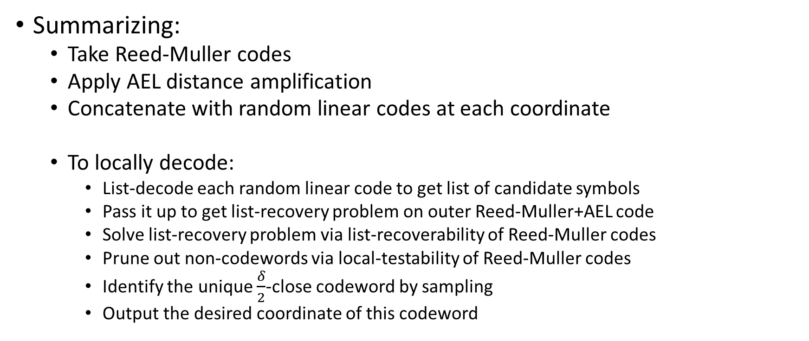
LCCs meeting the GV bound
Summarizing:
  Take Reed-Muller codes
  Apply AEL distance amplification
  Concatenate with random linear codes at each coordinate
  To locally decode:
    List-decode each random linear code to get list of candidate symbols
    Pass it up to get list-recovery problem on outer Reed-Muller+AEL code
    Solve list-recovery problem via list-recoverability of Reed-Muller codes
    Prune out non-codewords via local-testability of Reed-Muller codes
    Identify the unique $\frac{δ}{2}$-close codeword by sampling
    Output the desired coordinate of this codeword

Slide 49
Open questions
Make LCC query complexity match what is known for large alphabets
  subpoly(n)
LCCs meeting the GV bound for all $δ$
  Efficient non-local decoding upto $\frac{δ}{2}$ radius is also unknown
Explicit codes meeting the GV bound?
  Almost solved by Ta-Shma!
Is the GV bound tight?

