Slide 1
Tracing medieval Migration through Next Generation Sequencing: Finding Meaningful Models in a Sea of Data
Patrick Geary
Institute for Advanced Study

Slide 2
The Challenge of Genomic Scale Data
There has been much recent excitement about the use of genetics to elucidate ancestral history and Demography. Whole genome data from humans and other species are revealing complex stories of divergence and admixture that were left undiscovered by previous smaller data sets. Kelley Harris and Rasmus Nielsen
The coalescent with recombination describes the distribution of genealogical histories and resulting patterns of genetic variation in samples of DNA sequences from natural populations. However, using the model as the basis for inference is currently severely restricted by the computational challenge of estimating the likelihood. Gilean A.T. McVean and Niall J. Cardin
As it becomes easier to sequence multiple genomes from closely related species, evolutionary biologists working on speciation are struggling to get the most out of very large population genomic data sets. Vitor Sousa and Jody Hey

Slide 3
Traditional Image of Barbarian Migrations

Slide 4
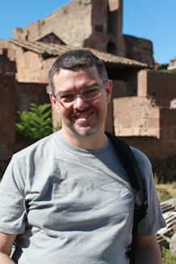
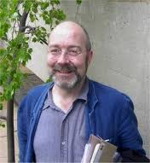
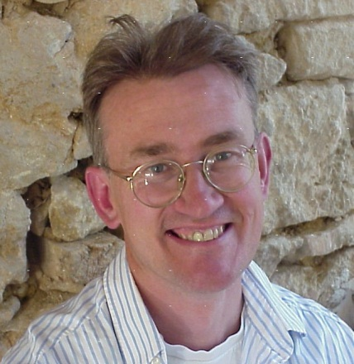
Guy Halsall
Civil Wars
Michael Kulikowsky
Constant Migration
Brian Ward-Perkins
Barbarian Invasions
Peter Heather
Barbarian Incursions
Michael Borgolte
Diffusion

Slide 5
Our Project
Focus on one of these barbarian “peoples,” the Longobards, about whom there is considerable written and archaeological evidence during the sixth century

Slide 6
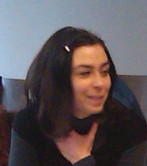
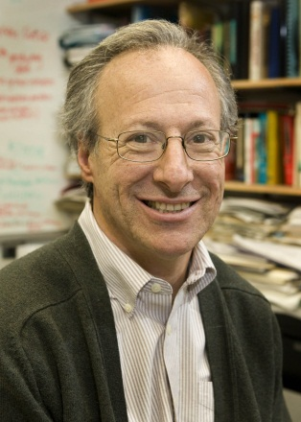
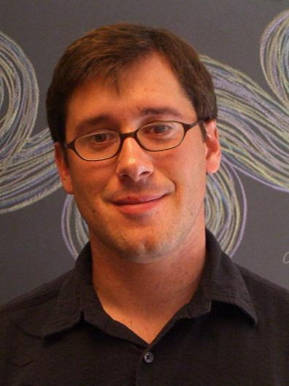
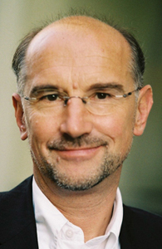
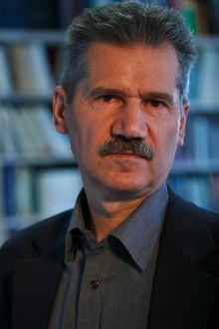
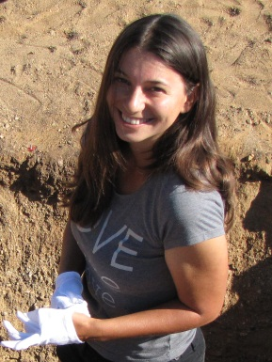
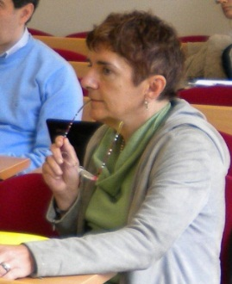
Archeologists
Some of our Team
Geneticists
Csanád Bálint, Budapest
Francesca Consolvan, Vienna
Guido Barbujani, Ferrara
Tivadar Vida, Budapest
David Caramelli,
Florence
Irene Barbieri, Budapest
Bob Wayne, UCLA
Falko Daim, Mainz
Caterina Giostra, Milan
Sauro Gelichi, Venice
Krishna Veeramah, Arizona
John Novembre, UCLA
Stefania Vai,
Florence
Walter Pohl, Vienna
Maria Cristina La Rocca, Padova
Daniel Peters, Berlin
Zuzana Loskotova, Brno
Historians
Physical Anthropologists
Kurt Alt, Mainz
Notes:
Csanad Balint; David Caramelli; Francesca Consolvan; Guido Barbujani; Tivadar Vida/ Bob Wayne; Sauro Gelachi; Caterina Giostra; Irene Barbieri; Falko Daim/ Maria Cristina La Rocca; Daniel Peters; Walter Pohl, John Novembre; Krishna Veeramah/ Kurt Alt

Slide 7
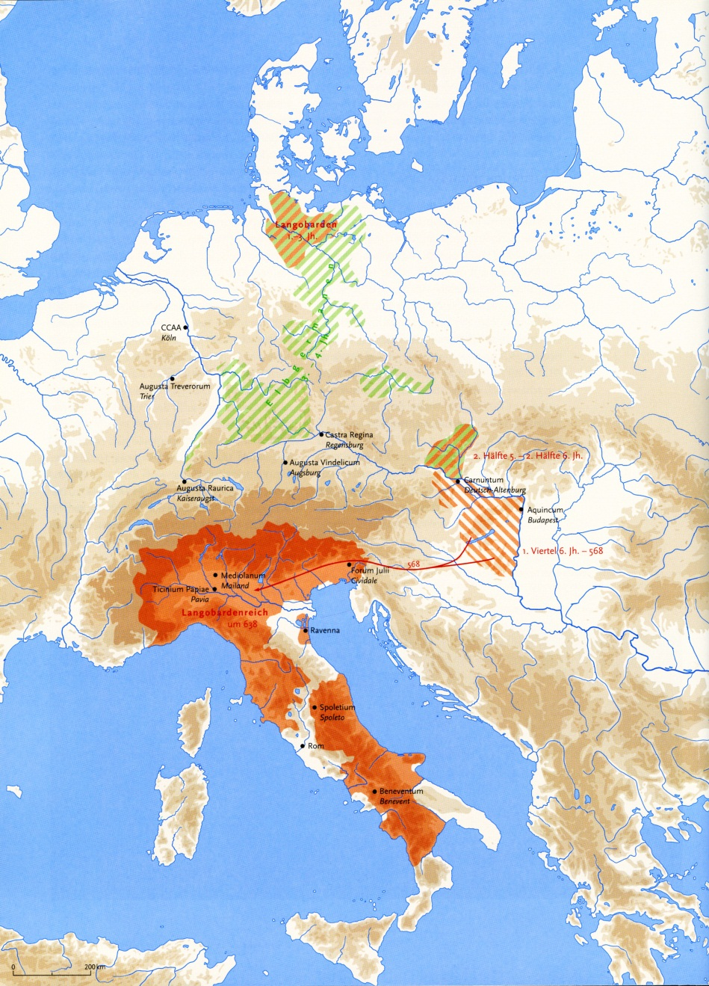
Presumed Longobard Settlements 1st to 6th Centuries

Slide 8
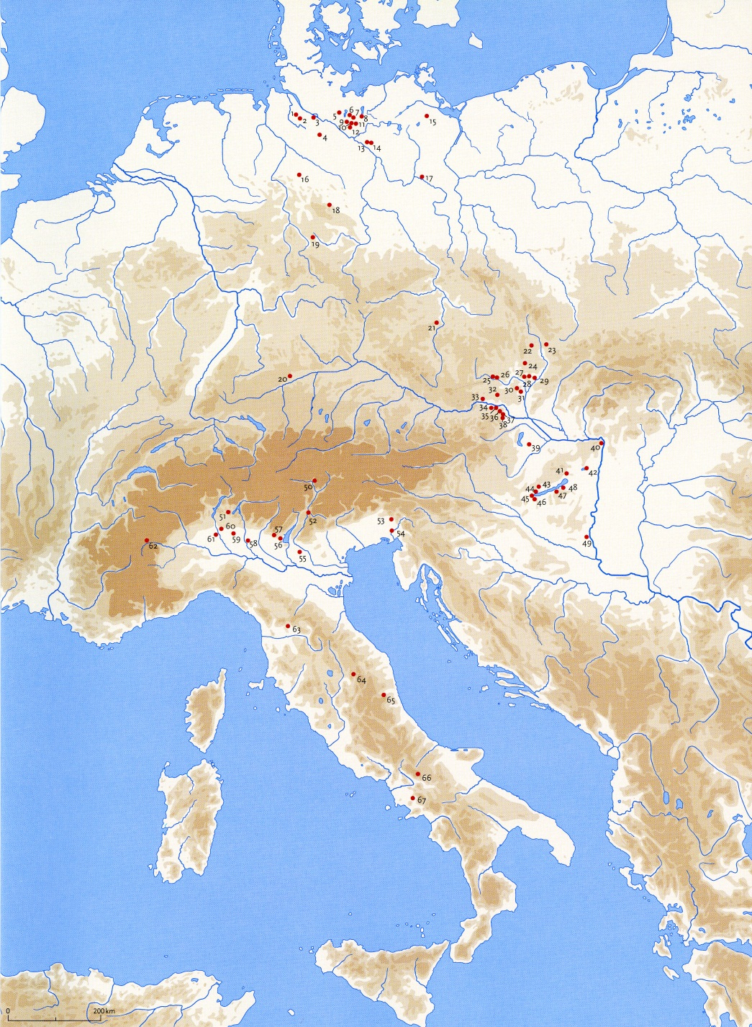
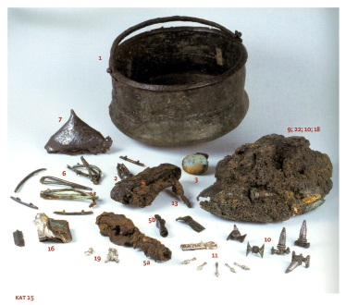
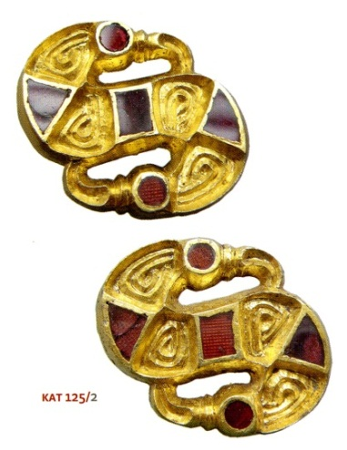
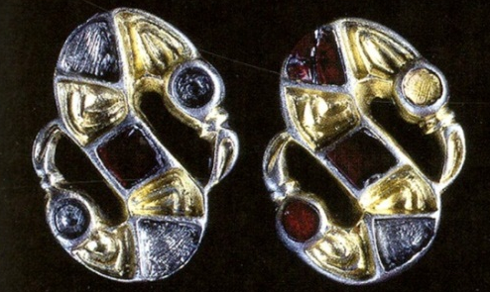
Presumed Longobard Cemeteries

Slide 9
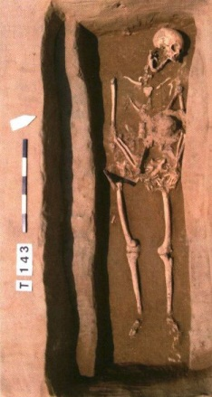
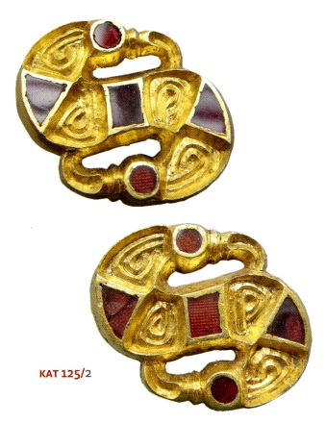
The circular argument of the ethnic paradigm*
Literal reading of texts including Paulus Diaconus Historia Longobardorum
Identification as Longobards of individuals buried with similar artifacts
Extrapolation from these sources to migration routes and historical territories
Identification of artifact types from these territories as ethnic indicators
Interpretation of distribution maps to fit ethnic territories
*With thanks to Susanne Hakenbeck

Slide 10
Questions
Does evidence of cultural movement necessarily mean that populations move?
Could cultural artifacts indicate status, wealth, age, or occupation rather than ethnic/national identity?
Did barbarian settlements in the Empire have a major demographic impact?
How endogenous were barbarian groups such as the Longobardi?
Do cultural differences map with genetic differences?

Slide 11
Our Project
Extract and characterize aDNA from ca. 800 individuals in Central Europe (Hungary, Czech Republic, Austria) and Italy identified culturally as Lombard as well as from near-by cemeteries that culturally seem “non-Lombard.”

Slide 12
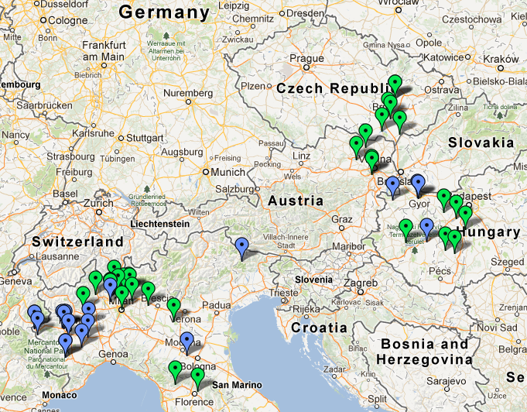
Actual and Potential Sites

Slide 13
Our Specific Questions
To what extent are Longobard and non-Longobard cemeteries structured by kinship rather than by gender, social status, or some other criteria?
What is the biological relationship between individuals buried in neighboring Longobard and non-Longobard cemeteries?
Are these populations significantly distinct biological groups or has there been substantial gene flow between groups even if their material culture suggests cultural differentiation? Moreover, if there was gene flow between these groups, is there evidence via mtDNA and Y-chromosomes of this process being sex-biased.
Is there genetic continuity between pre- (Pannonia) and post- (Italy) migration Longobard cemeteries?

Slide 14
Extraction and Sequencing
Step One: Sequence a portion of mtDNA from our samples, concentrating on Hypervariable region 1 (HVR 1)

Slide 15
Preliminary mtDNA Sites
Cesana Torinese, Loc. Pariol
Bardonecchia, Tur D'Amont
Collegno
Rivoli, Corso Levi
Mombello Monferrato
Rivoli, La Perosa
Centallo, San Gervasio

Slide 16
Network analysis of Piedmont Samples

Slide 17
Extraction and Sequencing
Step Two: Using Next Generation Sequencing (NGS) complete sequence of The mtDNA from samples from one Italian and one Hungarian site.
Step Three: Using NGS sequence nuclear DNA previous captured by RNA biotinylated probes.
Step Four (with funding) expand to all 800 samples

Slide 18
Collegno and Szólád

Slide 19
Next Generation Sequencing
Targets: ~5 megabases of DNA (~0.2% of the genome) focusing on specific types of genetic loci:
5,000 single nucleotide sites that are known to be informative in discriminating individuals from different regions of Europe (North, South, East and West).
These AIMs will help us :
To detect recent movement from northern Europe into Italy
to accurately infer kinship within individual cemeteries to the level of at least 2nd cousins.
5,000 1kb regions of contiguous sequence
These will allow us to apply population genetic theory to test competing models that describe the potential demographic histories of the region
Candidate sites in genes that have relevance to phenotypic variation.
Primarily loci thought to be involved in disease susceptibility and resistant such as bubonic plague and will be of interest to a wide number of researchers and historians.

Slide 20
Example of our Data
Partial sequence of three samples, from Hypervariable region 1 (HVR 1) from three Italian samples
Variance: result of sequencing error or evidence of genetic distance?
(The letters A, C, G, and T, represent the four nucleotide bases of a DNA strand — adenine, cytosine, guanine, thymine)

Slide 21
Analysis
What kind of inferences can we make from the genetic data we propose to collect given our questions of interest?

Slide 22
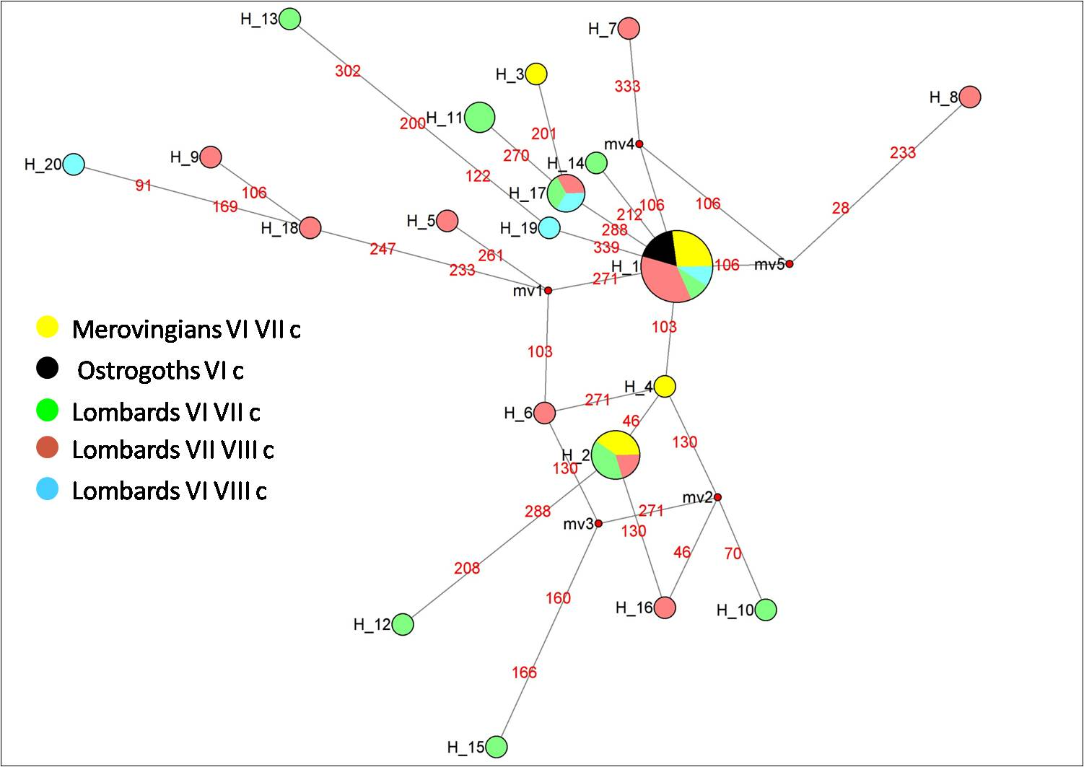
Uniparental Markers
Information derived from mtDNA and Y-chromosome will be useful for exploring the impact of sex-biased procesess
Preliminary Network Analysis of mtDNA Samples from Piedmonte cemeteries.

Slide 23
Examining autosomal DNA
Two major approaches from examining data from many loci are:
Unsupervised approaches
Model-based analyses

Slide 24
Unsupervised approaches
Unsupervised approaches do not involve testing alternative hypothesis about the data
“Eyeballing” of analysis is used to make interpretations
(though some statistical tests can be applied in certain circumstances)
Individuals are the unit of analyses
They are very useful for
Initially exploring data
Observing general patterns
Assessing data quality
generating hypotheses

Slide 25
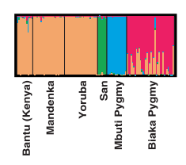
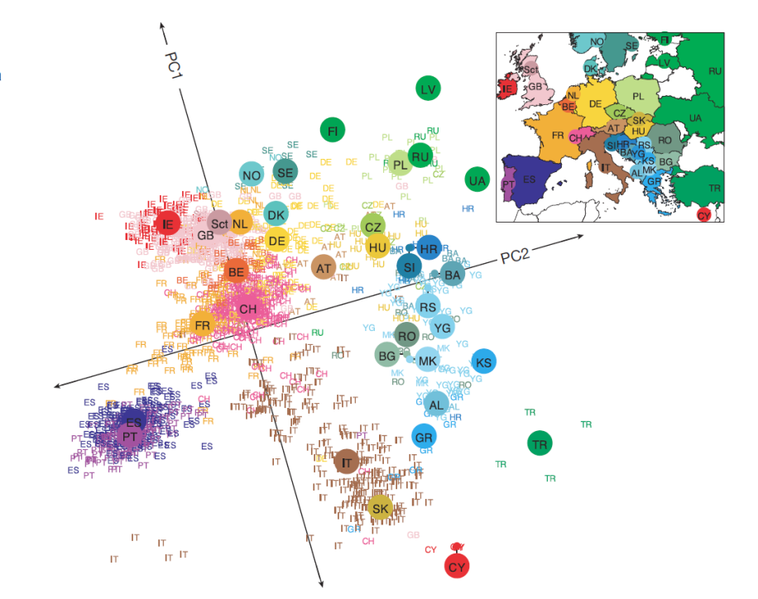
Examples of unsupervised analysis includes PCA and ancestry component analysis
Best performed using many independent SNPs (i.e. our 5000 AIMS)
Rosenberg et al. “Genetic Structure of Human Populations”. Science 2002
Novembre et. al. “Genes mirror Geography within Europe,” Nature, 2008).

Slide 26
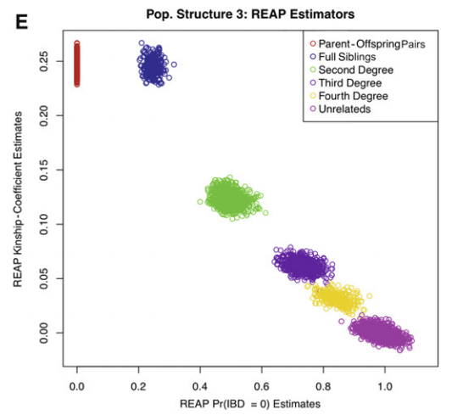
SNPs are also very powerful for examining kinship via estimation of the proportion of SNPs that are identical-by-descent between samples
Thornten et. al. “Estimating Kinship in Admixed Populations,” Am J Hum Gen, 2012).

Slide 27
Problem with SNP approaches
The act of picking sites in the genome that we already know segregate in certain individuals make them unsuitable for methods that utilize population genetic theory
For this we must utilize regions where there is no a prior expectation that:
a particular site will be variable over others
any variation will be at a particular frequency in a given population
The sequencing of the 5000 1kb regions is ideal for applications regarding pop gene theory and thus performing model-based analysis

Slide 28
Model-Based Approaches
In these approaches we test hypotheses/models against each other
Populations are (usually) the unit of analysis
Solutions to models can be generated and then compared to real data to see which hypothesis/model “best fits” the real data
Advantage is we can get an actual p-value for which model fits best our real data
Can also estimate parameters for these models
Obviously we cannot test all possible (sometimes infinite number) models so we must be smart and use prior knowledge to create them and eliminate very unlikely models
Will require communication between all disciplines to generate these models

Slide 29
Performing explicit modeling
In population genetics there are two major ways to generate a solution to a model
Backwards in time i.e. via the coalescent
Forward in time i.e. via diffusion approximation
In some scenarios the fit of a model to data can be done through elegant analytic solutions
Inference of a likelihood function
However sometimes the models are too complicated and so simulation-based approaches can be used
Approximate Bayesian Computation methods

Slide 30
What we will do with our Data
Construct models to explain observed genetic variation via methods discussed
Compare our models with those proposed by cultural archaeologists.
Compare our models with those proposed by physical anthropologists.
Compare our models with those proposed by textual historians.
Seek a combined model that can account for all types of data.

Slide 31
Demographic Models and Priors
Silvia Ghirotto
Model 1
Model 2
Nal
Ts
Nam
Nl
55 generations ago
Nl
Nm
Nm
Mutation rate µ: uniform (3.3*10-8, 8.3*10-7 per nucleotide per year )
Lombard effective population size Nl: uniform (1000,30000)
Modern effective population size Nm: loguniform (1000,100000)
Ancient Lombard_lineage population size Nal:uniform (10,1000)
Ancient modern_lineage population size Nam:uniform (10,1000)
Separation Time Ts: uniform (56,2000)
Summary statistics:
Haplotype number (Haptypes), Number of segregating sites (SegSites), Mean Number of Pairwise Differences (PairDiff), Haplotype Diversity (HapDiver) for each population; Allele Sharing (with respect to the ancient population) and Hudson’s Fst.

Slide 32
Power Analysis: Type I Error
The performance of the ABC procedure has been tested using simulated datasets under known models. Datasets simulated under a particular model (in turn Model1 and Model2) are used as pseudoobserved (PODS) data to determine whether the ABC method is able to identify the true model as the most likely.
We analyzed 1,000 PODS for each model both with the rejection and the regression procedures
We tested several threshold to assign support to the model (from 0.5 to 0.9)
Modern sample size = 50 (lowest sample size among our modern populations)

Slide 33
Model 1 true
 |  | MODEL1 | MODEL2
REJECTION (n retained sims=100) | threshold | >0.5
 |  | 0.993 | 0.007 | 0
 |  | >0.6
 |  | 0.99 | 0.001 | 0.009
 |  | >0.7
 |  | 0.984 | 0 | 0.016
 |  | >0.8
 |  | 0.98 | 0 | 0.02
 |  | >0.9
 |  | 0.962 | 0 | 0.038
 |  | true positives | false positives | not assigned
 |  | MODEL1 | MODEL2
REGRESSION (n retained sims=50,000) | threshold | >0.5
 |  | 0.99 | 0.01 | 0
 |  | >0.6
 |  | 0.989 | 0.007 | 0.004
 |  | >0.7
 |  | 0.984 | 0.003 | 0.013
 |  | >0.8
 |  | 0.983 | 0 | 0.017
 |  | >0.9
 |  | 0.968 | 0 | 0.032
 |  | true positives | false positives | not assigned

Slide 34
Model 2 true
 |  | MODEL1 | MODEL2
REJECTION (n retained sims=100) | threshold | >0.5
 |  | 0.013 | 0.987 | 0
 |  | >0.6
 |  | 0.01 | 0.983 | 0.007
 |  | >0.7
 |  | 0.007 | 0.978 | 0.015
 |  | >0.8
 |  | 0.006 | 0.966 | 0.028
 |  | >0.9
 |  | 0.003 | 0.962 | 0.035
 |  | false positives | true positives | not assigned
 |  | MODEL1 | MODEL2
REGRESSION (n retained sims=50,000) | threshold | >0.5
 |  | 0.011 | 0.989 | 0
 |  | >0.6
 |  | 0.008 | 0.987 | 0.005
 |  | >0.7
 |  | 0.006 | 0.985 | 0.009
 |  | >0.8
 |  | 0.006 | 0.981 | 0.013
 |  | >0.9
 |  | 0.003 | 0.971 | 0.026
 |  | false positives | true positives | not assigned

Slide 35
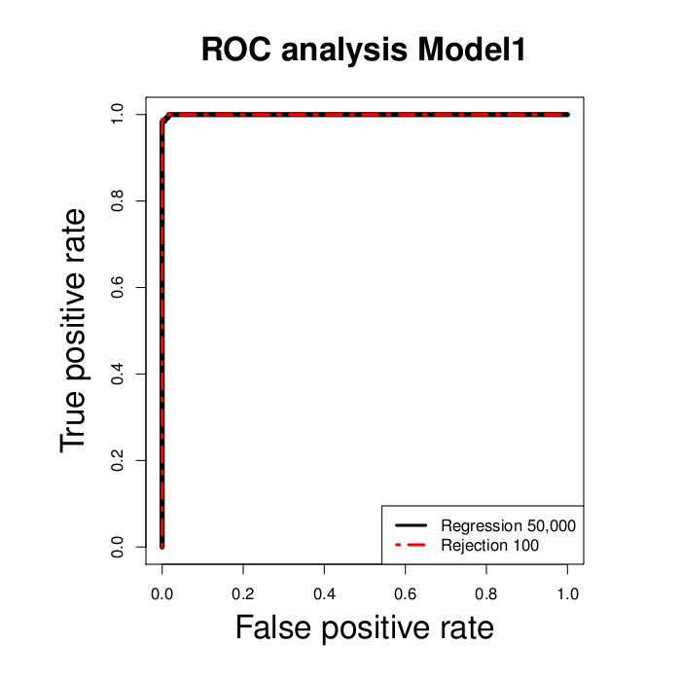
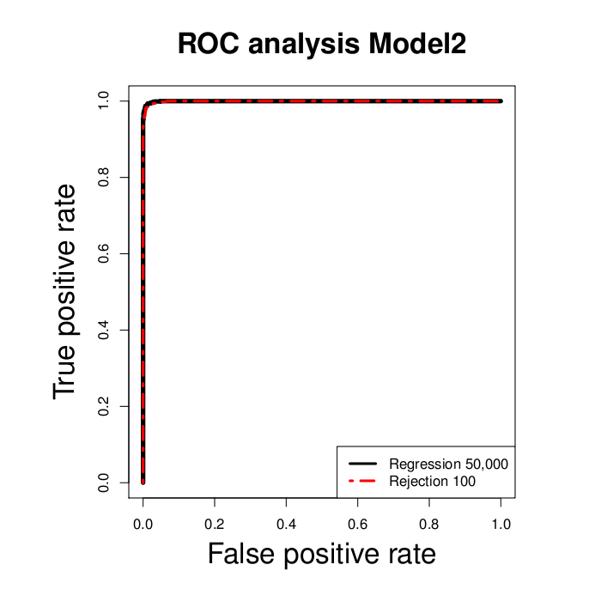
Receiver operating characteristic (ROC) curve analysis
The method ranks the posterior probabilities for one model, say e.g Model 1, from highest to lowest. For each of these posterior probabilities we know whether or not the data actually came from the true model. The ROC curve is constructed by successively taking the posterior probabilities in the list from highest to lowest and plotting the proportion of true positives (PODS that are correctly classified) and the proportion of false positives (PODS that are uncorrectly classified). The ideal case occurs when all the probabilities assigned to the true model occur first in the list, in which case the area under the ROC curve (AUC) would be equal to 1.

Slide 36
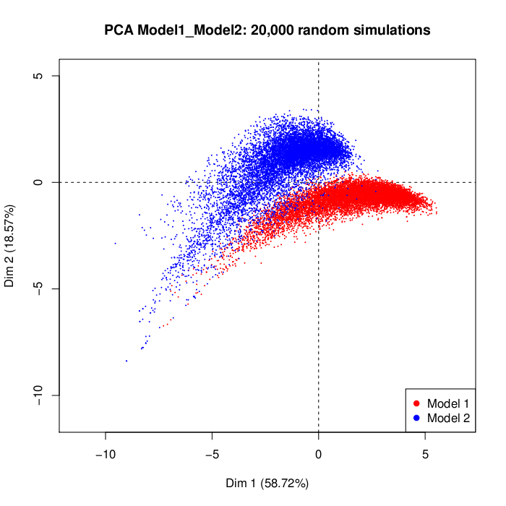
Principal Component Analysis all statistics

Slide 37
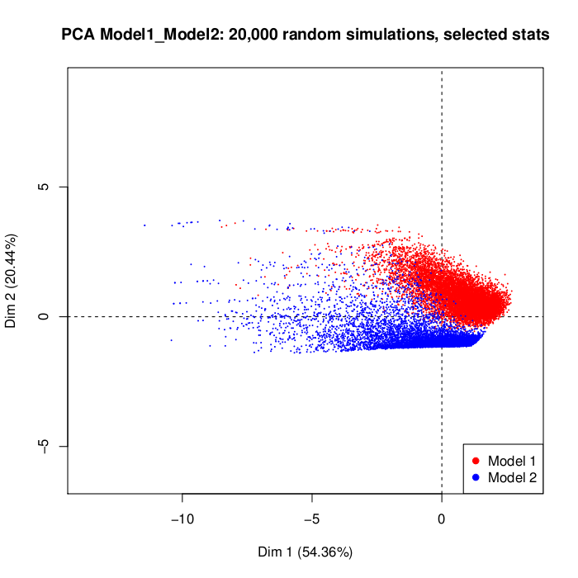
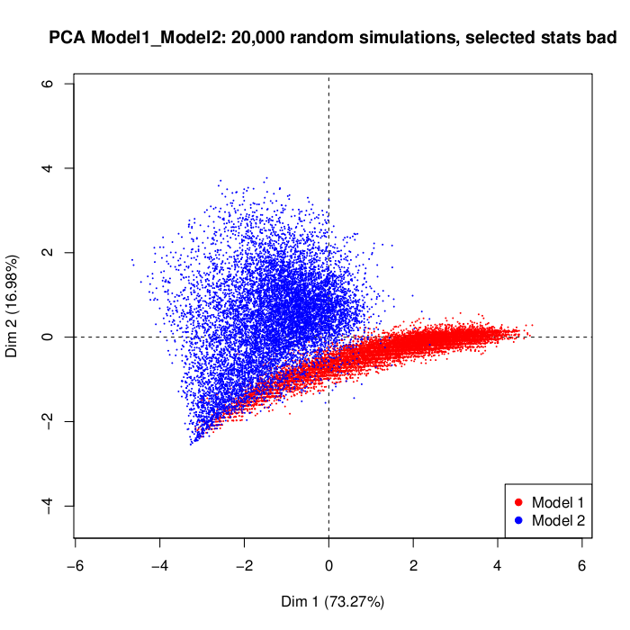
PCA first five statistics
 | KW-chisquared | df | pvalue
AS0vs1_1 | 130.363 | 105 | 0.047
Haptypes_0 | 59.726 | 49 | 0.140
PairDiff_1 | 5658.352 | 5587 | 0.249
HapDiver_0 | 721.656 | 720 | 0.476
HapDiver_1 | 234.558 | 234 | 0.477
PairDiff_0 | 8333.530 | 8327 | 0.478
Fst_01 | 9842.925 | 9836 | 0.478
SegSites_1 | 123.840 | 125 | 0.513
SegSites_0 | 157.101 | 176 | 0.844
Haptypes_1 | 10.645 | 27 | 0.998
PCA last five statistics

Slide 38
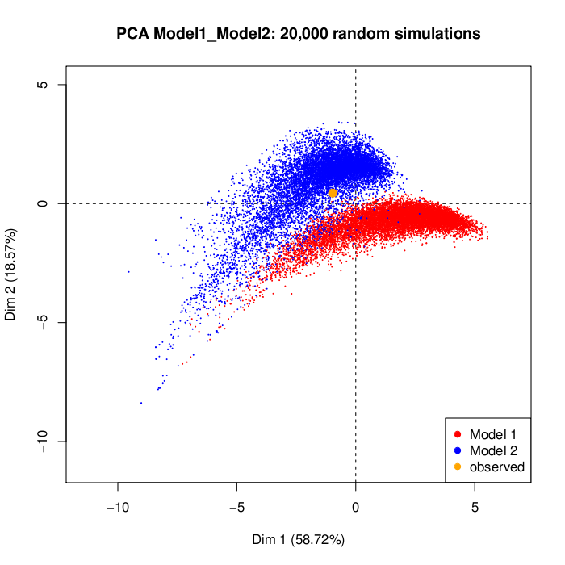
ABC analysis: TORINO
Model 1
Model 2

Slide 39
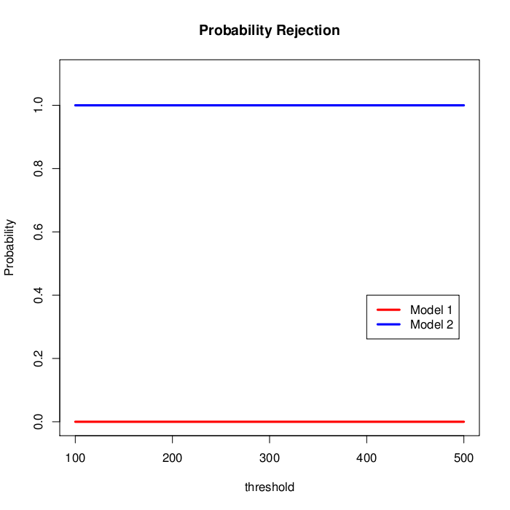
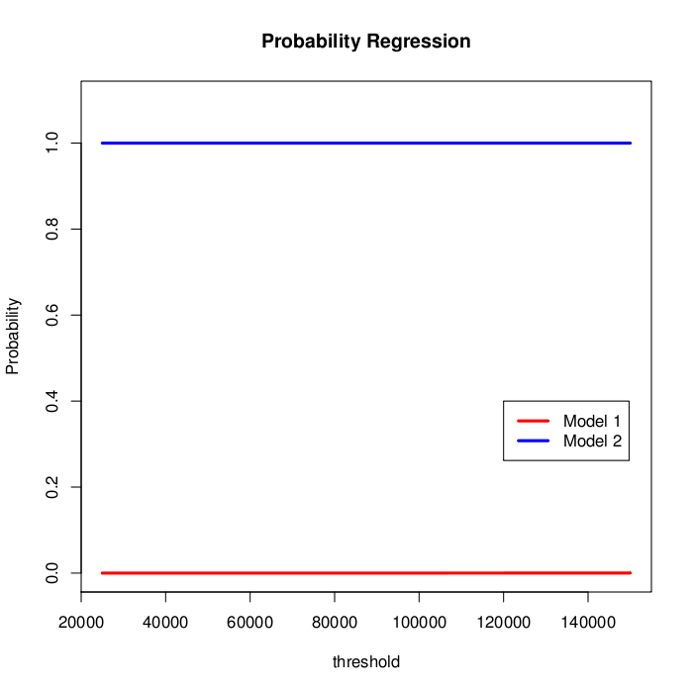
Model Selection
All the summary statistics
1,000,000 simulations each model

Slide 40
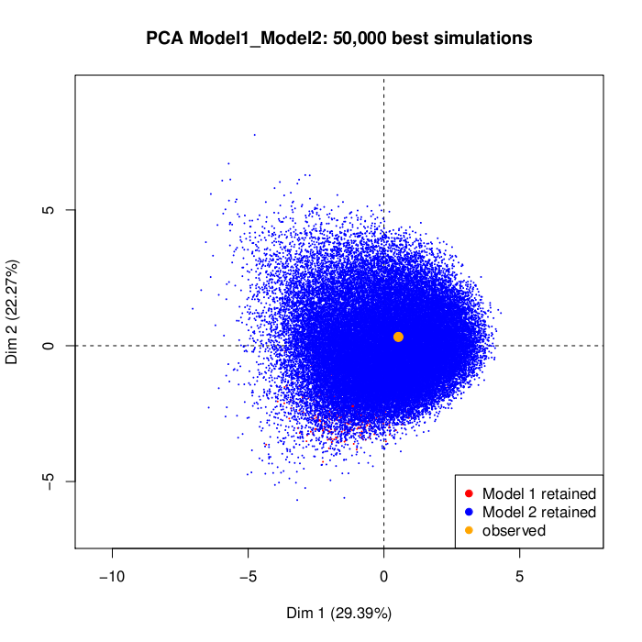
PCA 50,000 retained simulations

Slide 41
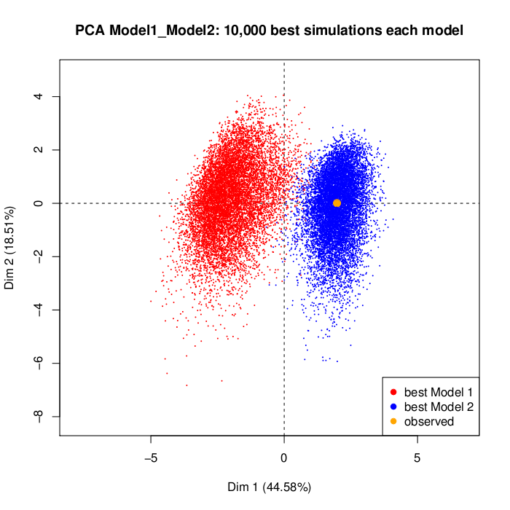
PCA best 10,000 simulations for each model

Slide 42
Problems with Simple Model
Two Populations (we might suppose 6 or more that would require models that could not be displayed in a three dimensional space)
Non-recombinant mtDNA allows relatively simple explorations of models using the Wright Fisher model plus the coalescent

Slide 43
Wright Fisher model plus the Coalescent

Slide 44
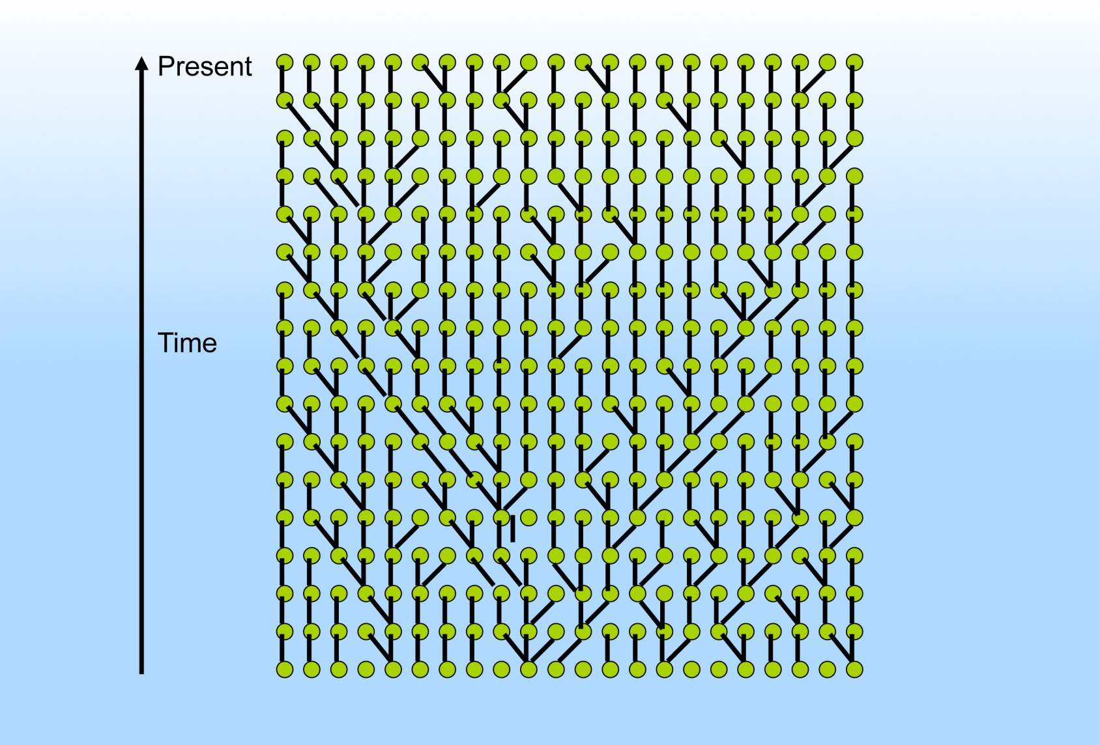
Finding the Coalescent

Slide 45
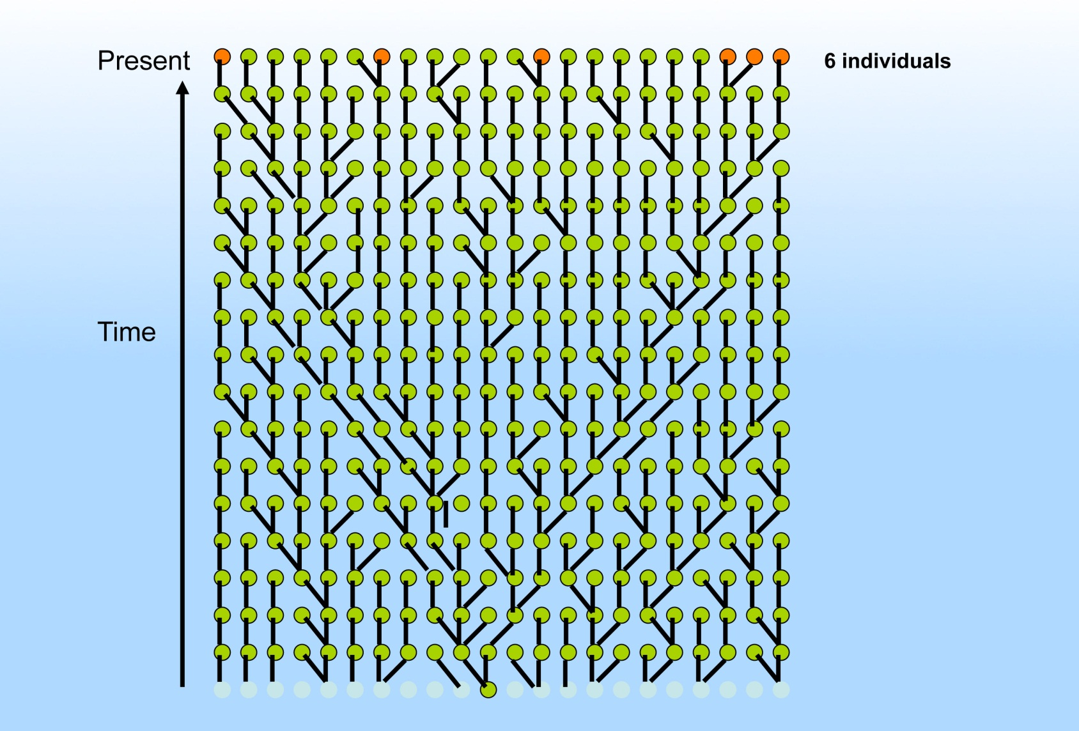
Finding the Coalescent

Slide 46
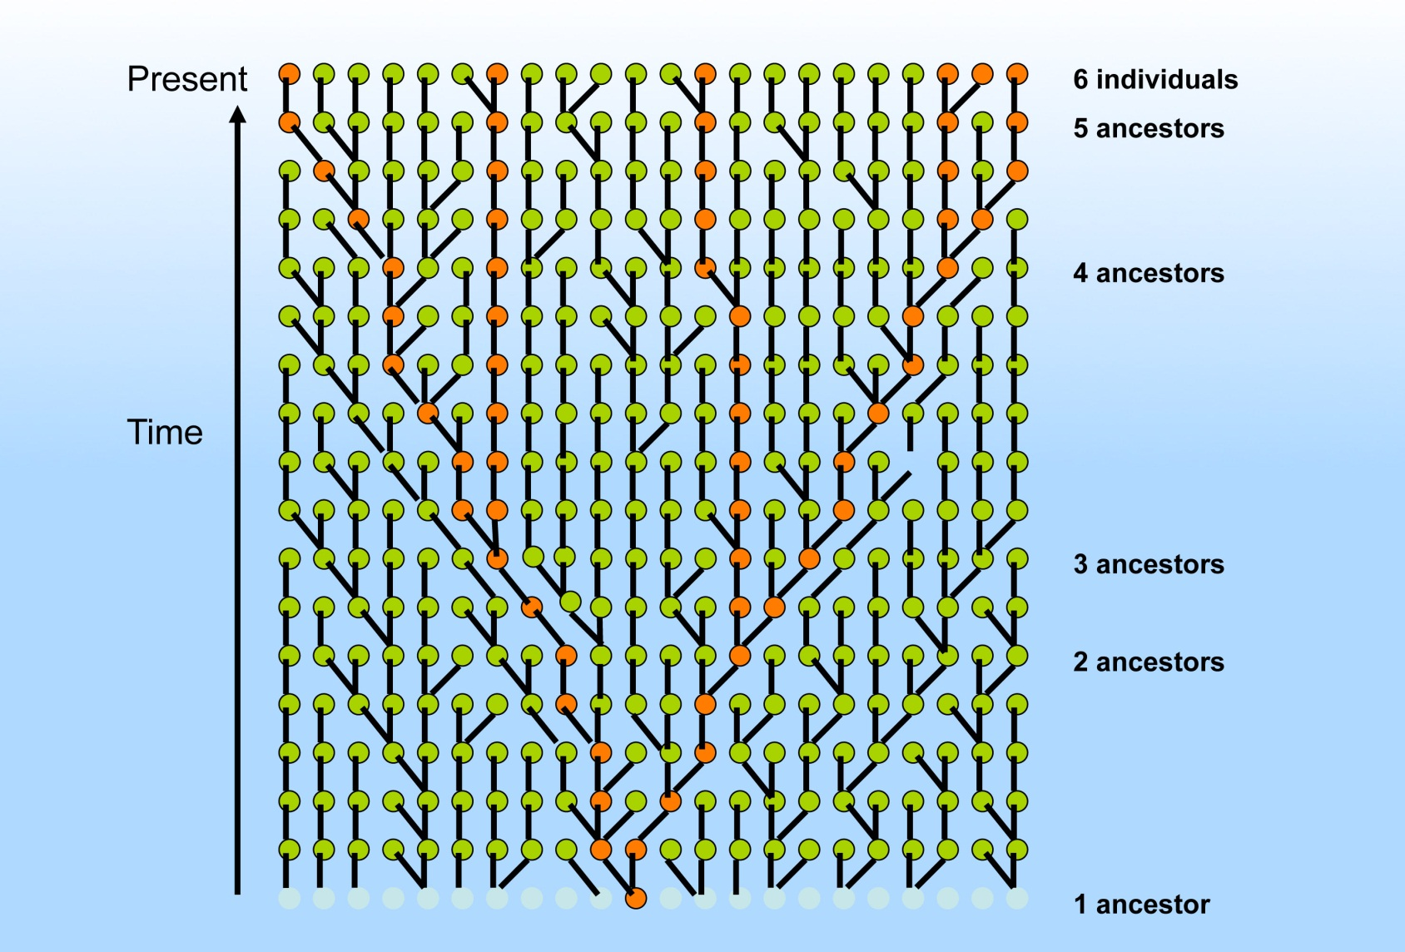
Finding the Coalescent

Slide 47
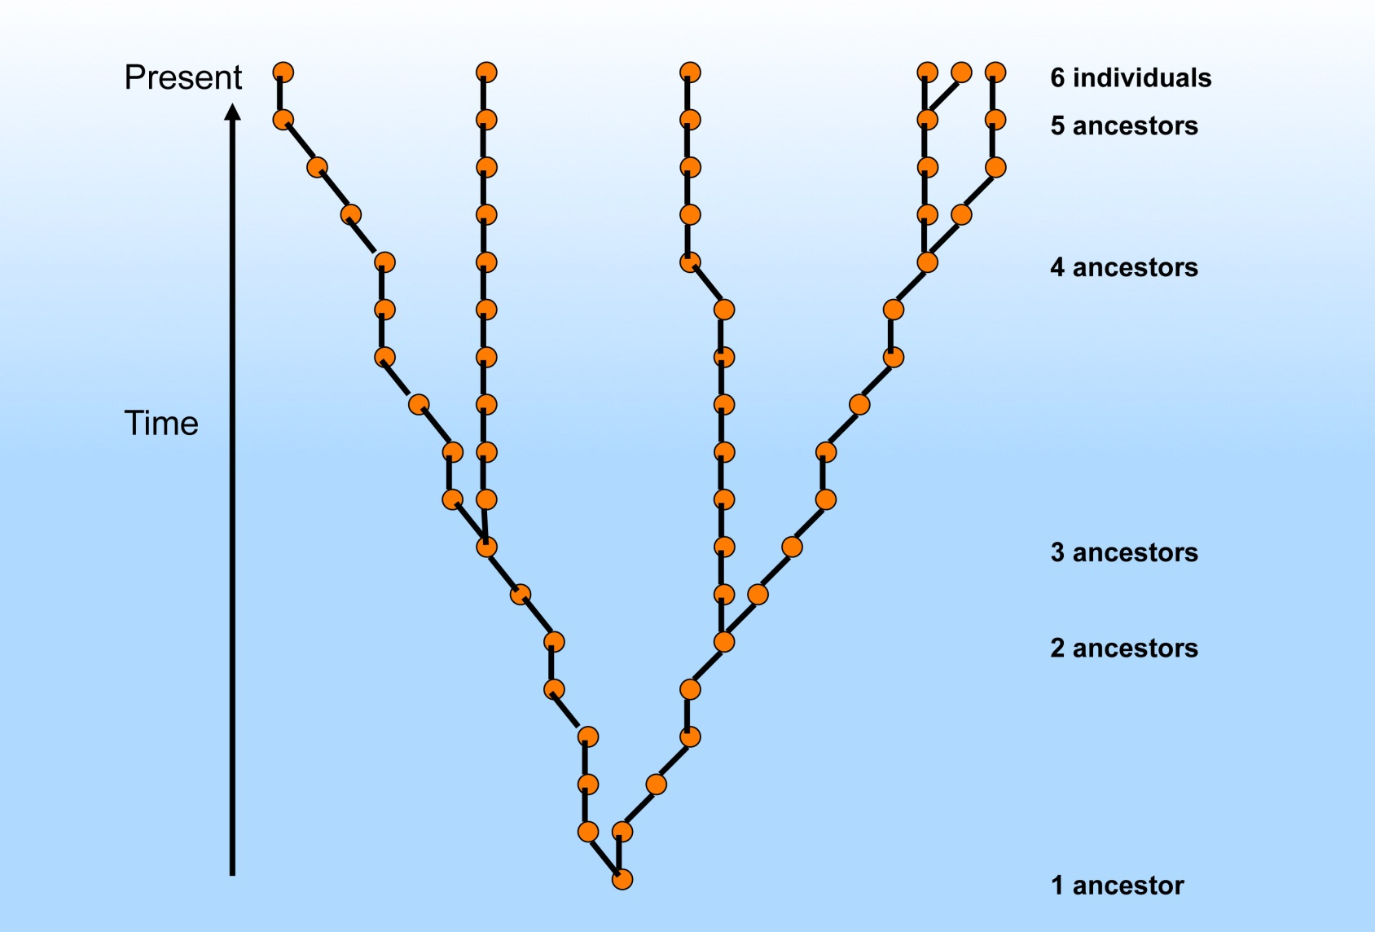
Finding the Coalescent

Slide 48
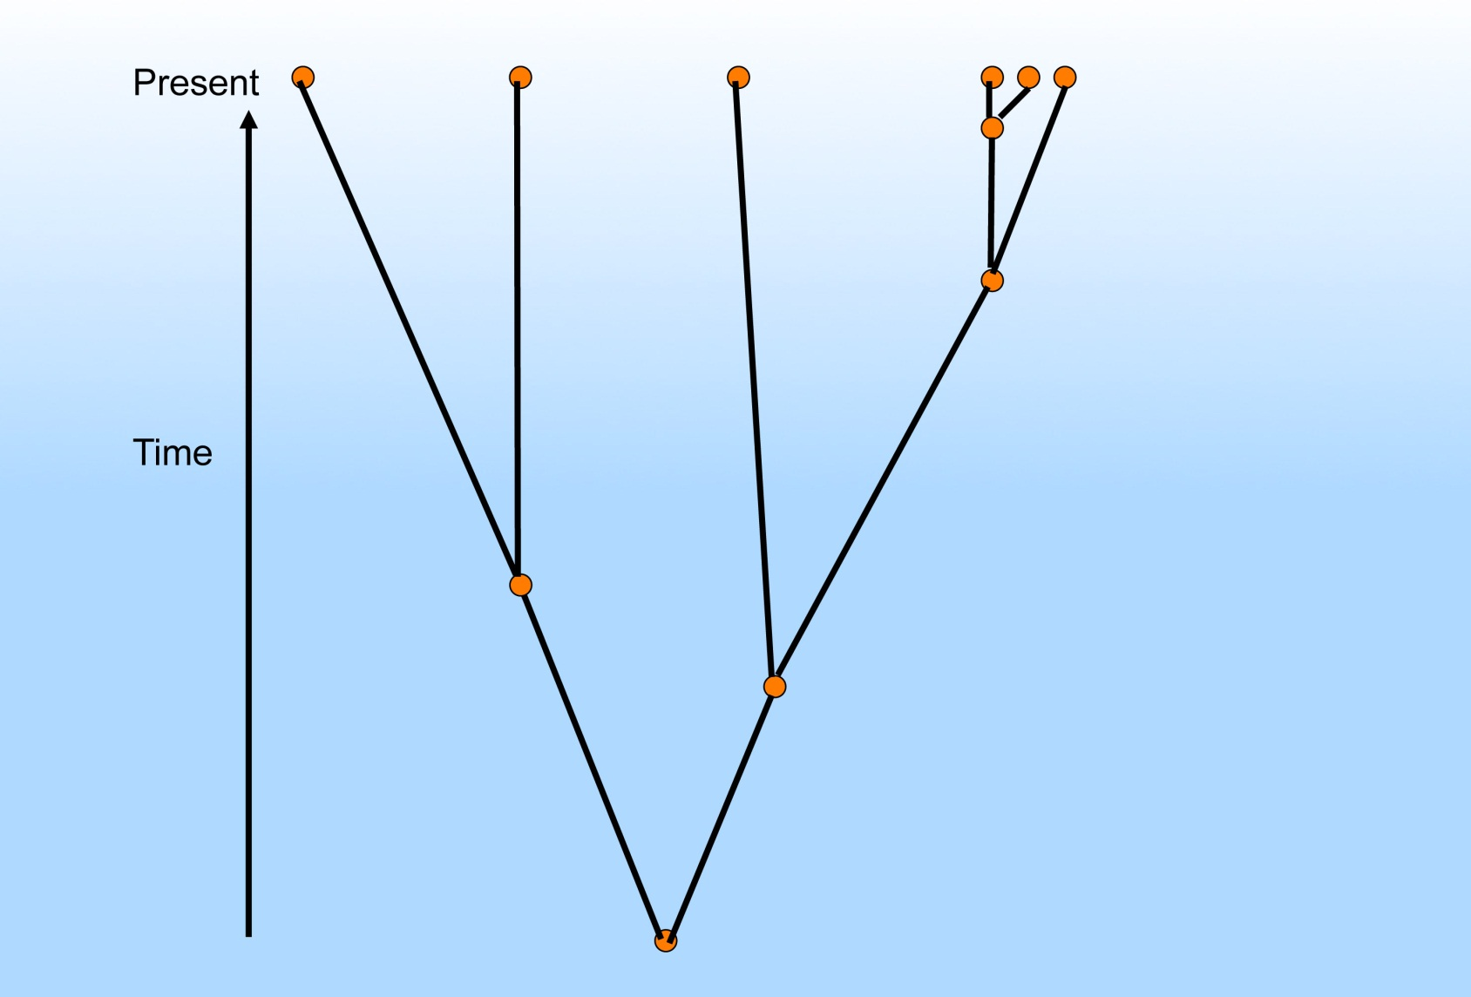
Finding the Coalescent

Slide 49
Four genealogies produced from the same population history

Slide 50
Challenge of Recombination From Tree to ARC

Slide 51
Additional Challenges Challenges
Obtaining international cross-disciplinary cooperation
Educating geneticists, historians, and archaeologists on the possibilities and limitations of each other’s disciplines
Obtaining valid sequence data from very old specimens
Finding the 300,000 euro that I need to finance this project.
Developing appropriate population genetics models to recover probable histories from our data

Slide 52
Some Bibliography
Heng Li1 and Richard Durbin, “Inference of human population history from individual whole-genome sequences, “Nature 475 (28 July 2011): 493–496.
Kelley Harris and Rasmus Nielsen, “Inferring Demographic History from a Spectrum of Shared Haplotype Lengths,” PLoS Genet 9(6): e1003521. doi:10.1371/ journal.pgen.1003521
Vitor Sousa and Jody Hey, “Understanding the origin of species with genome-scale data: modelling gene flow,” www.nature.com/ reviews/genetics
Magnus Nordborg, Coalescent Theory” in D J Balding; M J Bishop; C Cannings, Handbook of Statistical Genetics vol. 2 (Chichester: 2007), 843-877.

Slide 53
Questions/ Suggestions?

